Slide 1
Joint Defra/EA FCERM R&D programme - project FD2662
Flood and coastal erosion risk management and the local economy
CASE STUDIES
Part A: Initial sample
Godmanchester – Nottingham – Redcar - Sandwich
March 2014
© Frontier Economics Ltd, London.

Slide 2
summary

Slide 3
Headline findings in this study
This report explores the potential contribution to the local economy from investment in flood and coastal erosion risk management (FCERM). Four case studies have been explored to test a new methodology for assessing such impacts. Commentary is also provided of when a contribution to the national economy is more likely.
Key findings relating to GVA impacts for the local economy
Observation | Example | Potential implication
1. Accounting for the impacts of FCERM on the local economy can add significant benefits to those already assessed under standard FCERM appraisal methods | The Nottingham FCERM intervention could offer annual benefits to the local economy of £3.1 million - £9.7 million on top of the £584,000 annual benefits already assessed under FCERM appraisal methods. | In some cases the additional benefits to the local economy can add significantly to those already assessed. This could have implications for the consideration of relative returns to FCERM investment across interventions.
2. Across all case studies, the majority of businesses are small or micro-sized (less than 10 people). Yet these are most likely to lack adaptive capacity and be at risk of significant flood disruption costs. | Across all four case studies, 70-75% are likely to have low adaptive capacity. Godmanchester, Redcar and Sandwich all have significant proportions of micro businesses | Increasing adaptive capacity of small and medium-sized businesses, alongside wider flood risk management options, is likely to help alleviate potentially significant disruption costs in the event of a flood and contribute to GVA. FCERM plays a particularly important role where adaptive capacity is limited.
3. The local GVA impacts of FCERM are likely to be relatively greater when there are dense populations of high GVA businesses with low adaptive capacity | Nottingham has the highest density of business activity of all four case studies. | Relatively greater GVA returns from Partnership Funded FCERM are more likely in areas with dense populations of high value-added businesses with low adaptive capacity; and when the FCERM protects infrastructure on which businesses depend for their productivity.
4. FCERM has the potential to unlock substantial investment, when considered as part of a wider package of measures | Nottingham and Sandwich had Enterprise Zone developments were facilitated by FCERM; Redcar included FCERM within a broader regeneration set of measures. | This could point to the benefits of integrating FCERM into area plans for regeneration and local (or national) economic growth policy

Slide 4
Headline findings in this study (continued…)
Observation | Example | Potential implication
5. Where tourism is important to the local economy interdependencies mean FCERM can benefit not only the tourist attraction, but also the surrounding businesses and local economy (such as hotels, eateries etc). | Redcar is very dependent on tourism. A holistic area-wide integrated approach was taken to regenerating the area | Areas with significant tourist revenue benefit disproportionately from an integrated approach to flood planning
6. Interdependencies mean the system-wide benefits to the local economy from FCERM could be even greater than those that are currently amenable to quantification. | Almost all businesses have supply chains of some form and rely on public infrastructure (e.g. transport and utilities). Some businesses also benefit from co-located businesses through enhanced efficiency. | FCERM lowers the systemic risk of flooding in the local area. Understanding how businesses and organisations are interdependent on each other and infrastructure is critical to the assessment of benefits.
7. FCERM is able to indirectly support economic activity – but this benefit is also difficult to quantify | Godmanchester houses commuters who contribute high value labour to Cambridge and London. Such homes contribute to the supply of housing in the South-East | Indirect support for economic activity from FCERM could be significant – further research is needed to better understand the scale of this potential effect
Key findings relating to GVA impacts for the national economy
The analysis suggests that a contribution to the national economy of FCERM investment is more likely where:
Investment is unlocked because of the unique characteristics of the local area (and that investment would not otherwise be made in another area)
Agglomeration benefits or other interdependencies: if businesses are able to remain in their first-best location (where they are more productive) rather than moving to a less productive area, then the national economy benefits from agglomeration and the efficiencies of interdependencies. Protecting supply chains or infrastructure in which businesses rely is also likely to lead to a national gain.
Lowering damage to commercial property, public infrastructure and agricultural outputs is a national benefit.

Slide 5
Main report

Slide 6
1. Introduction and structure of the report
Introduction
This report presents a method for estimating the contribution to the wider economy of flood and coastal erosion risk management (FCERM) measures. Measures considered are those funded through government Flood Defence Grant in Aid (FDGiA) and external contributions through Partnership Funding and not actions or investments taken by individual businesses to protect themselves against flood risk. Measures include physical flood defence schemes, as well as wider flood management options such as awareness-raising campaigns.
The contribution to the economy is quantified where possible and measured as Gross Value Added, GVA. This is complemented with qualitative assessments. The full method is described in “TOOLKIT for assessing the impacts of flood and coastal erosion risk management on the local economy”. The primary focus is on local GVA, and associated key drivers of the impacts on the local economy. Assessment is also provided of the conditions under which national GVA effects are likely. Whether impacts are likely to affect the local economy, or translate into national economy impacts, in part depends on the geographical area under consideration.
The analysis presented in this report considers the geographical area of the local economy equal to the area considered by the Environment Agency Flood and Coastal Erosion Risk Management Appraisal Guidance (FCERM-AG).
Our previous work – Technical Report 1 - described a proposed methodology for estimating the scale of these effects quantitatively and qualitatively. This report provides:
A reminder of the approach to estimating the GVA effects of FCERM at the local and national level;
Application of the methodology using 4 case study FCERM interventions in: Godmanchester, Nottingham, Redcar and Sandwich.
An overview of key findings relating to the conditions under which the contribution of FCERM to local, and national, GVA is likely to be material and when it is not.
As the methodology for assessing GVA impacts of FCERM, and its application, are in their infancy, it is likely that the approach and data will need to be reviewed and updated over time as a richer evidence base comes to light. Ranges around the results are provided where possible to reflect a degree of uncertainty.
We are very grateful to the stakeholders we spoke to for evidence as part of this study. They are listed in Annex 3.
Structure of this report
We present the following in this report:
Section 2 provides an overview of the case studies that will be considered later in the analysis.
Section 3 summarises the methodology from Technical Report 1. This is high level but includes the approach and key assumptions made within the analysis.
Section 4 presents the case study analysis covering:
Godmanchester;
Nottingham;
Redcar; and
Sandwich.
Section 5 offers overarching observations and messages from the case studies. In particular, this identifies the conditions under which GVA effects are more likely to be material and when they are not. It also highlights how our findings may be important for policy making purposes.

Slide 7
2. The case studies
Selection of the case studies
Application of the methodology has been undertaken using real case study FCERM interventions. To select the case studies, we worked with Defra and the Environment Agency to develop selection criteria. These were then matched against the available information on interventions held by appraisal teams.
The criteria for selection are shown in the box below.
Case study selection criteria.
Using these criteria, four case studies were selected.
The case studies
The four case studies are briefly described below.
Godmanchester
Godmanchester is a rural Roman town situated in the Huntingdon area of Central Cambridgeshire. The scheme has a 1.5km stretch of flood defences, encompassing a series of flood defence walls and embankments delivering 1 in 100 standard of protection.
Variation in geographic distribution across the country
Variation in distribution of economic activity (urban/rural)
Variation in the type of flood defence investment
a. New build, renewal or maintenance
b. scope of protection provided by defensive structures e.g. large barriers protecting multiple economic centres or local area protection only
Availability of appraisal data and information
Knowledge of local contacts
Nottingham
The city of Nottingham is situated in the Lower Trent Area of the East Midlands Region. The scheme involved raising or replacing parts of the existing defences that were below the standard required to provide protection against 1 in 100 year floods.
Redcar
Redcar is a coastal town located in North East England to the east of Middlesbrough and south of the Tees Estuary. The intervention includes replacement of the seawall and works at the seafront which reduce the flood risk and prevent loss of property and infrastructure due to coastal erosion. It provides a 1 in 300 standard of protection.
Sandwich
Sandwich is a medieval town and civil parish on the right bank of the River Stour in East Kent. The FCERM intervention involved embankment raising, improved and raised defences, a tidal flood relief area and flood walls. This delivers a 1 in 200 level of protection.

Slide 8
3.1 Reminder of overarching methodology
Context
We examine the contribution to the economy of investing in flood risk management measures because:
First, it helps build an understanding of their potential impacts on the local economy. This would be expected to increase the propensity for local partners to contribute funding to FCERM as part of the government’s Partnership Funding approach.
Second, it helps us to understand the conditions under which a potentially national impact on the economy may be likely.
The Environment Agency currently has detailed guidance for appraising the economic, environmental and social impacts of FCERM interventions. Some economic impacts are assessed within that framework such as the expected annual damage to commercial properties or loss to agricultural production. These current assessments relate specifically to impacts in the short term post-flood (we call these ‘first round impacts’).
Our approach uses the current appraisal as the starting point but builds on it to account for wider impacts on economic activity by explicitly considering businesses’ likely responses to flood risk. Our approach is intended to be:
consistent with the current FCERM appraisal framework; and
proportionate, recognising the need to keep assessment burdens to a minimum.
To inform our analysis we have used a range of published evidence (much of which was referenced in Technical Report 1 in detail) and stakeholder input (see Annex 3).
Framework
Our general framework for the analysis is the transmission mechanism. This maps out how the risk of flooding transmits into impacts on factors in the figure below.
The transmission mechanism
Flood risk
First round impacts (immediately after the flood)
Assets expected to be affected in the first instance, such as properties or infrastructure
Costs and efficiency
These are affected by the first-round impacts
Business responses
Businesses face significant flooding uncertainty. This can affect their business decisions.
Dynamic impacts (occur over time)
Business decisions could lead to impacts on:
Business continuity and sustainability of business activity,
Unlocked investment or new development in the area, or
Spillovers such as those arising from the interdependency of sectors and markets

Slide 9
3.2 Overarching methodology – understanding likely business responses
The transmission mechanism provides a framework for understanding the impacts on the local economy of flood risk. As explained in Technical report 1, we assume that business responses to flood risk are, at the basic level, driven by two factors:
Adaptive capacity (AC): The ability of a system/organisation to design or implement effective adaptation strategies to adjust to information about potential climate change (including climate variability and extremes), moderate potential damages, and take advantage of opportunities, or cope with the consequences (definition from the IPCC, 2007); and,
Location dependence (LD): operational factors (e.g. scale of assets, proximity to other businesses); reliance on local markets (customer, labour or supplier markets); reliance on local assets (land, infrastructure etc).
Using published evidence alongside stakeholder discussions, we have developed a preliminary ‘look-up’ table (as in Annex 2) which sets out the likely AC and LD for each sector, by size category of business (note this must be validated using local evidence on a case by case basis). This was then used to characterise the business activity in the local economies of the case study areas. We can use these to inform the likely business response to flood risk, shown in Figure 3.
Figure 3: Business Response Framework and Assessment Metrics
Assessment Metrics
Location Dependence
Stay + Do Nothing
Business continuity – FCERM can lower the degree of flood-related disruption.
High
Low
Stay + Adapt
Firms are assumed to invest optimally so the opportunity cost of investing in adaptation is equal to the avoided damage to their property and business activity. FCERM lowers expected damage and hence requirements for adaptation investment. Freed up funds are invested with a return at least equal to adaptation.
High
Stay + Adapt
Stay + Adapt OR Move
Medium
Stay + Adapt OR Stay + Do Nothing
Stay + Adapt OR Stay + Do Nothing OR Move
Adaptive Capacity
Move
FCERM can minimise the loss of business activity that occurs if some businesses move out of the local area and are not replaced
Low
Stay + Do Nothing
Stay + Do Nothing
New investment
Additional investment in the area generated or facilitated by the FCERM

Slide 10
3.3 Key assumptions underpinning the analysis
General assumptions
The methodology outlined in “TOOLKIT for assessing the impacts of flood and coastal erosion risk management on the local economy” is underpinned by a series of important assumptions. These have been made in order to allow the impacts of business responses to be estimated, and are set out below.
First Round impacts
These are assessed within the suite of impacts considered in the FCERM-AG. They trigger business responses and in turn, dynamic impacts. First round impacts of FCERM are reductions in:
Expected damage to commercial properties (premises, inventories, machinery etc.);
damage to public infrastructure (utilities, for example);
business travel disruption;
loss of agricultural output and yield
Estimating business response to flood risk
Businesses operate in the context of uncertainty about when, how, what scale, how long and how often they may experience flooding. They have to make business decisions to manage the risks they face. Some businesses may not even be aware they are at risk of flooding. Our assumptions are:
In response to flood risk, businesses respond in one of 4 ways: stay and do nothing; stay and adapt; move or shut down.
Businesses have the same form of response before the FCERM intervention as after i.e. if they didn’t adapt before FCERM then they would not adapt with FCERM.
When businesses stay and adapt, we assume that they adapt ‘optimally’ given the risk of flooding they face i.e. the reduction in expected annual damage is equal to their investment in adaptation. The implementation of FCERM reduces the business’s need to invest in adaptation. This allows it to allocate the funds to another activity which provides returns comparable to those that would have been provided by investing in adaptation. The value of the damage avoided by adaptation provides a reasonable approximation of the GVA impact of the investment of the funds freed up and is an estimate that more readily available (from the FCERM-AG) for use in the analysis.
All businesses in a flood plain are affected by the risk of flooding so activity is not displaced within the flood plain.
If businesses move or shut down due to risk of flooding, they are not replaced by new business development.
Dynamic Impacts
Dynamic impacts reflect the outcomes for a local economy over time as businesses respond to changes in flood risk. FCERM would be likely to:
Support business continuity and sustainabiliy of business activity in an area;
‘Unlock’ investments that might otherwise have been constrained or unattractive given the flood risk; and,
Lead to ‘spillover’ impacts which reflect interdependencies or other intangible impacts on economic activity.
The next section presents case study analysis of this approach.

Slide 11
4. The case studies
Godmanchester
Nottingham
Redcar
Sandwich

Slide 12
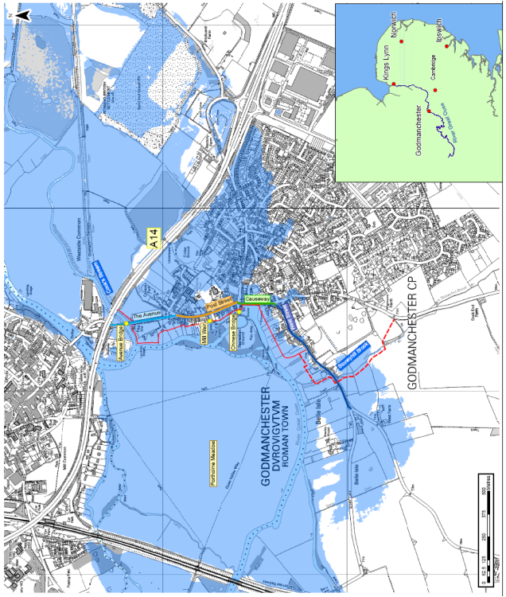
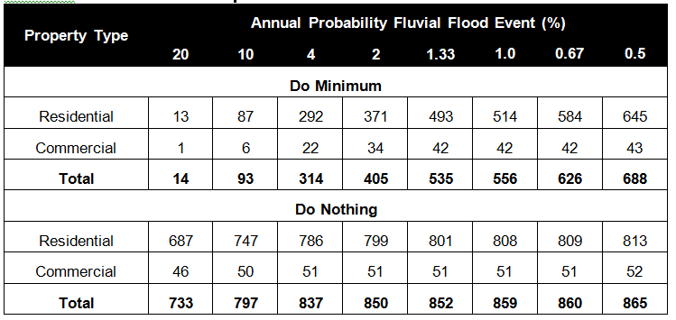
4.1 Godmanchester - Introduction
1
2
3
4
What was the level of flood risk in the Godmanchester area?
Godmanchester is a rural Roman town situated in the Huntingdon area of Central Cambridgeshire. The town itself lies on the banks of the River Great Ouse. Much of the recent commercial and residential estates have been developed in the low lying areas of the town, meaning a large proportion of commercial properties in the town are particularly at risk of fluvial flooding.
The town has been hit by a number of severe floods in the past century, with the most recent at Easter in 1998, categorised as a 1 in 25 year flood. Hydrological modelling undertaken as part of the appraisal process has shown that in the absence of any flood defences, 514 residential and 42 commercial properties would be at risk of flooding with a 1% annual probability (1 in 100 year flood event) flood event. The relevant floodplain is shown in the figure top-right. The lower-right figure highlights the number of properties at risk of flooding with various annual probabilities.
The modelling suggests that on average, in the absence of any flood defences, properties would flood during events with greater than a 10% annual probability of occurring.
The intervention
A number of different intervention options were considered as part of the flood alleviation plan in Godmanchester. In this study, we assess the economic impact of the preferred option identified in the project appraisal. Started in 2008, this involved the construction of a 1.5km stretch of defences, consisting of a series of flood defence walls and embankments. The scheme also involved the construction of two pumping stations to control seepage in the event of high water flows. The scheme was funded primarily through Flood Defence Grant in Aid, with a small contribution from local councils. Anglian Water was also consulted with regards to the appropriate pumping stations to implement.
The scheme itself was designed to provide protection from floods with a 1% (1 in 100) annual probability of occurring.
The floodplain and properties affected by flooding in Godmanchester
Source: Environment Agency Project Appraisal
Source: Environment Agency Project Appraisal

Slide 13
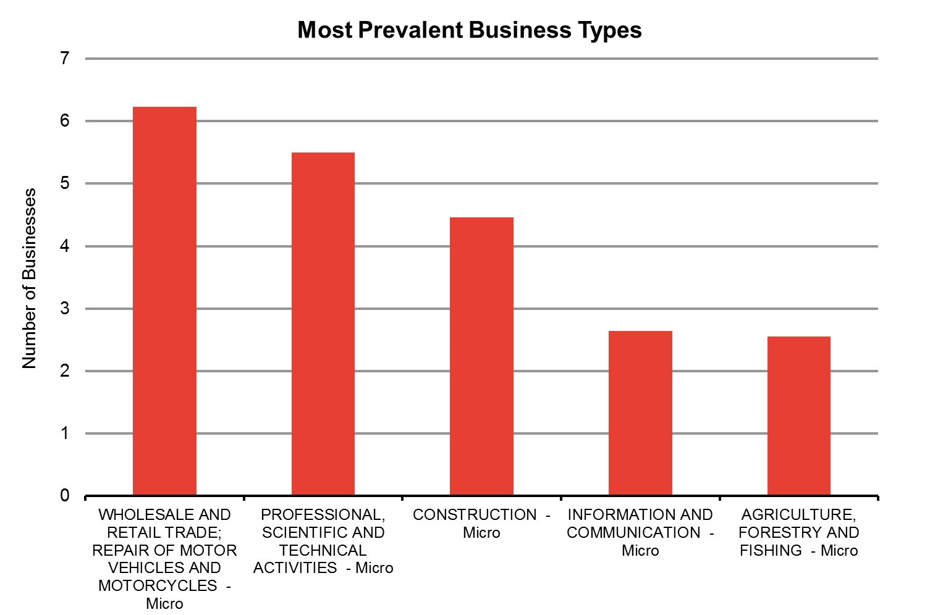
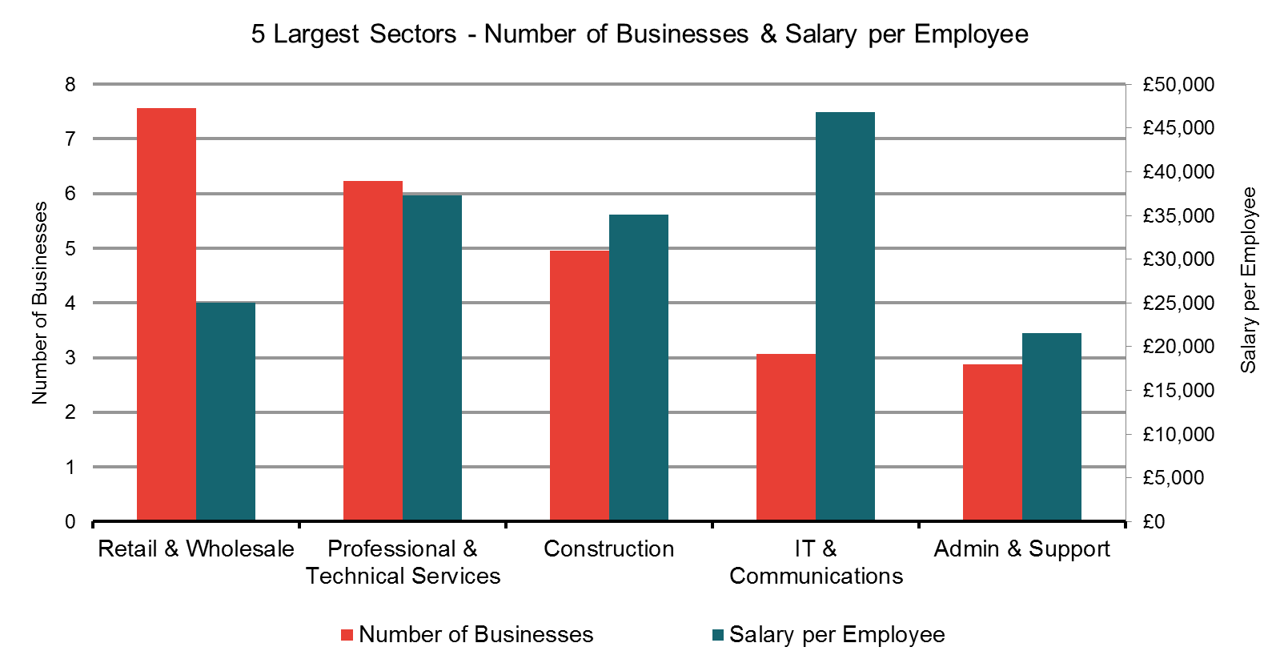
4.1 Godmanchester – Business Characterisation
1
2
3
4
Economic activity in the local area
Godmanchester is a small rural town with a population of just over 6,000, many of which are commuters given the town’s strong links with Cambridge, London and the nearby town of Huntingdon. The town is therefore a strong ‘feeder’ for economic activity in these areas. The town itself is mainly home to small independent retail and construction businesses. However, its proximity to Cambridge means that some high-value professional service and scientific businesses, as well as architecture and IT firms, are located in the town. The town is also adjacent to Portholme, the UK’s largest meadow, and is surrounded by rich fertile land. A couple of agricultural and forestry companies are therefore located in the floodplain area.
Business categorisation
In order to proxy the number of businesses directly protected by the scheme, we used the protected number of commercial properties identified in the existing FCERM appraisal. This suggests that 42 businesses in the floodplain are protected from 1 in 100 year flood events as a direct result of the flood defence scheme.
In categorising businesses into the relevant business sectors, we have used business data from the ONS Neighbourhood Statistics database for the Huntingdonshire local authority area. Regional data for the South East was used to split businesses by business size within each sector. As the data used is not specific to Godmanchester itself, the sector composition is therefore indicative; actual types of businesses may vary slightly from our estimate.
The business categorisation indicates that:
Small retail businesses represent the highest proportion of businesses in the floodplain. ‘Micro’ businesses (less than 10 employees) represent over 80% of all businesses, 20% of these being wholesale or retail businesses. Based on the data available, we have identified no large businesses (250+ employees) in the Godmanchester area.
There is a hub of small IT, and professional/technical firms in the local area. The data shows that IT firms, and firms providing professional, scientific and technical services, represent around 20% of businesses in the floodplain. These professional firms are key to the local area, given the value they create.
A couple of agricultural and forestry businesses reside in the floodplain. This is expected, given the rural nature of the town.
Source: Frontier Analysis based on ONS & BIS business data

Slide 14
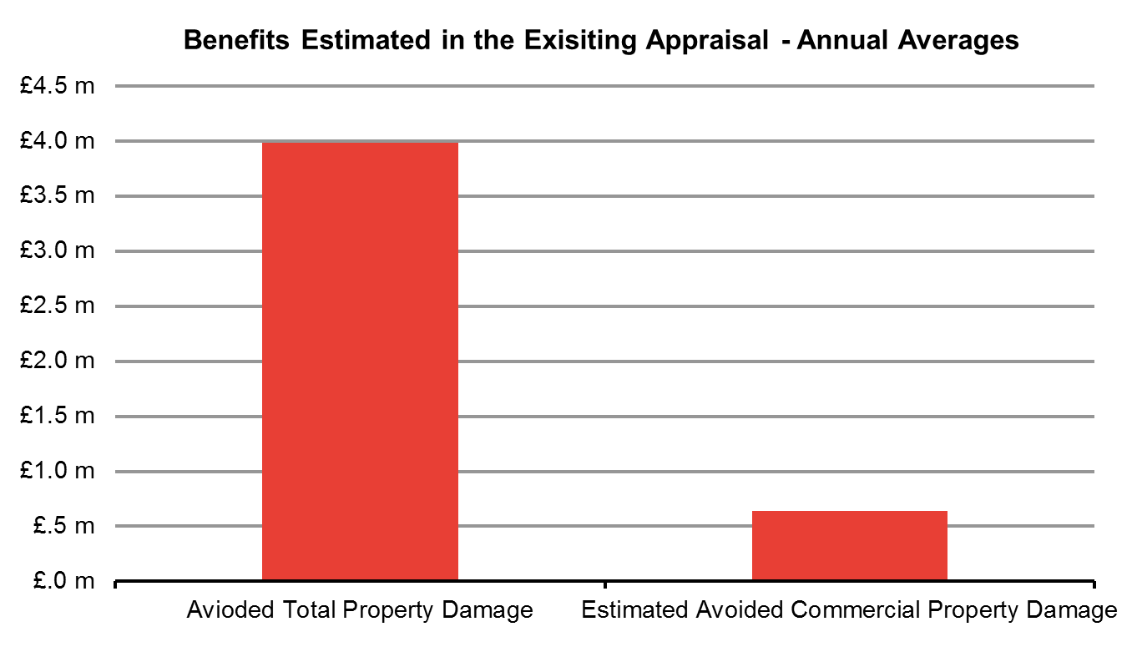
4.1 Godmanchester – First Round Impacts
1
2
3
4
What first round impacts does the Godmanchester scheme generate?
To ensure that we were taking a proportionate approach, we start with the economic benefits already quantified as part of the EA’s existing economic appraisal (the PAR) to estimate the ‘first round’ impacts. In other words, we simply re-present the economic impacts captured in the existing appraisal as GVA impacts on the local economy.
The existing appraisal focussed solely on quantifying the avoided damage to properties in the floodplain. As set out in Technical Report 1, the scheme could potentially generate additional GVA through a number of other avenues, for example through avoided damage to transportation and utilities infrastructure, and disruption to agricultural production. However, such benefits were considered to be negligible in the EA’s economic appraisal, and were therefore not quantified explicitly.
The EA’s project appraisal estimated the expected damage costs to all types of property under the “Do Nothing” and “Do Something” Scenarios (i.e. both with and without the intervention). Based on evidence in the appraisal PAR, the EA estimated that the scheme would reduce total expected property damage by £115m in present value terms over the 100 year lifetime of the asset. Of this £115m, £18.5m related specifically to avoided commercial property damage. Using this, we then derived the relevant PV estimates for our analysis:
First, we converted the £18.5m 100-year PV into an annual average figure. This was calculated based on the schedule of social discount rates set out in the Treasury Green Book. Through these calculations, we find that by abating commercial property damage during floods, the scheme generates an expected £640,000 of additional GVA on an annual basis.
This translates into a total present value benefit of around £5.3m, when these benefits are considered over the 10-year GVA appraisal horizon.
This impact is particularly large, given that only 42 commercial properties are protected by scheme. Based on the evidence in the PAR, this is driven by the fact that commercial properties are likely to be disproportionately affected in the event of a flood. The evidence suggests that in PV terms over a 100 year period, the scheme saves an expected £400,000 of damage per commercial property, almost double the average for residential properties.
Source: Frontier Analysis based on the Godmanchester PAR
Annual Benefits
£640,000
10-Year PV Benefits
£5.3m
Source: Frontier Analysis based on the Godmanchester PAR

Slide 15
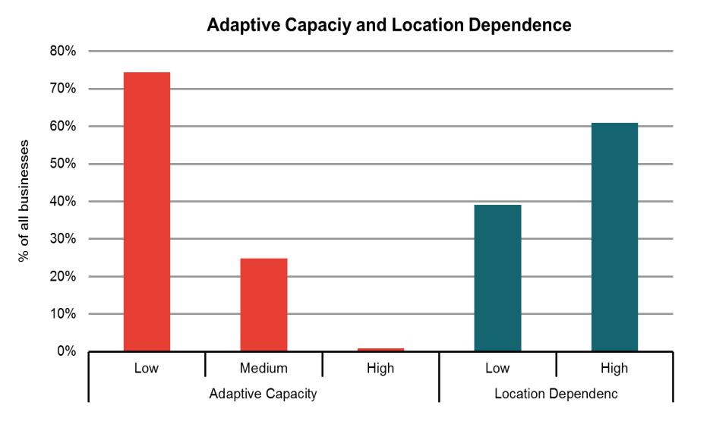
4.1: Godmanchester – Adaptive Capacity & Location Dependence
1
2
3
4
Evidence from stakeholders on adaptive capacity and location dependence
We gathered evidence on the likely adaptive capacity and location dependence of businesses in Godmanchester by using available evidence on these factors from published studies and through interviews with stakeholders. We spoke mainly with individuals in the local district council with knowledge of the business environment in Godmanchester (a more detailed summary of stakeholder evidence for each case study area is provided in Annex 1). We found that overall, stakeholder evidence supports the published literature.
The majority of local businesses in the area are small micro-sized businesses. The evidence suggests that lack of awareness and knowledge of flood risk mean they have limited adaptive capacity. Stakeholders mentioned that business owners prioritise activities that affect the day-to-day running of their businesses, rather than the longer-term risk of a flood. A large proportion of commercial properties in Godmanchester are also old listed buildings. This would make it difficult to gain planning permission for physical adaptation, and costly to implement such measures if permission was granted. Restrictions from leasing/renting their commercial properties were also mentioned. Stakeholders also mentioned that a large proportion of businesses are likely to be location dependent. Given their small size, businesses in Godmanchester rely heavily on local connections for trade.
What is the likely Adaptive Capacity and Location Dependence of local businesses?
To determine the adaptive capacity and location dependence of each business in the floodplain, we used our ‘preliminary look-up table’. We developed this as an indication of the likely level (low, medium or high) of adaptive capacity and location dependence (low or high) for each business type, based on published evidence and our stakeholder engagements. Using this indicative assessment, we find that overall, a significant proportion of businesses in Godmanchester are not likely to have the capacity to take adaptation action, and are likely to be particularly dependent on their current business location. This is discussed further in the box opposite. We indicatively estimate:
74% of all businesses are likely to have low adaptive capacity. Only 1% are likely to have high adaptive capacity.
Around 61% of businesses are likely to have high location dependence.
Source: Frontier Analysis
According to the data available, we estimate that approximately 74% of all businesses are likely to have low adaptive capacity. This is driven by the fact that the majority of businesses in the town are micro businesses. We estimate that only 1% of businesses are likely to have ‘high’ capacity to adapt.
Around 61% of businesses are likely to have particular ties to the local area. This is driven by the large proportion of small retail businesses in the area, which tend to rely quite heavily on local connections for trade. The professional and technical services firms in the town are also likely to have strong location preference to be in the area, given its proximity to the stock of high-skilled labour in Cambridge and Huntingdon.

Slide 16
4.1: Godmanchester – Business Responses
1
2
3
4
Evidence from local business representatives
Through our stakeholder interviews, we also gathered information on the likely responses of different types of businesses. This is again summarised in more detail in Annex 1.
Overall, the interviews suggested that businesses would not be likely to relocate or adapt in response to flood risk. Given their small size, businesses would be unlikely to have the funds to re-locate, and would be particularly reliant on local connections for business. Of those we spoke to, none of the stakeholders was aware of any business that had moved solely as a result of flooding. One stakeholder mentioned he was aware of only a few businesses that had taken steps to protect their properties following the Easter 1998 floods. This suggests that many businesses would be likely to suffer significant damage to commercial and productive capabilities in the event of a flood.
Likely Business Responses
In order to determine the likely responses of each business in the floodplain, we use our preliminary ‘business look-up table’ and applied this to the business characterisation of the Godmanchester area.
Given the limited evidence that was available, we were unable to assess the extent to which some businesses would shut down or re-locate as a result of flooding. However, the evidence suggests that these are least preferred options for most businesses. We therefore assess the impact of this only as a sensitivity test.
To reflect uncertainty around how businesses may respond to flood risks, we illustrate a range of possible business responses. This is done by varying the percentage of businesses with medium adaptive capacity that adapt. Specifically, we assume all those businesses with high adaptive capacity will adapt. To generate the ranges, we then assume between 25% and 75% of those with medium adaptive capacity will also adapt.
Given the likely constrained levels of adaptive capacity, our analysis suggests that:
7% - 19% of businesses would be likely to adapt. This range reflects the number of businesses with high adaptive capacity plus 25% to 75% of those with medium adaptive capacity. This means that of the 42 businesses located in the floodplain, between 3 and 8 businesses could potentially choose to protect themselves from flooding in some way. This reflects the low levels of adaptive capacity and high location dependence that most businesses in Godmanchester are likely to have.
The decision to adapt is driven in part by the sector the business is in. Of all businesses in the area, those in the construction and professional/technical/scientific services industries would be most likely to adapt. The majority of these businesses have to deal with risk on a day-to-day basis, and are therefore most likely to be aware of their susceptibility to flooding and how they can best mitigate that risk.
As a sensitivity, we consider the impact of businesses with high or medium adaptive capacity but low location dependence re-locating in the absence of the scheme. These businesses are those most likely to move, and are also an important part of the local business environment.
% likely to adapt
7 – 19%
Number of businesses likely to adapt?
3 - 8

Slide 17
4.1 Godmanchester – Dynamic Impacts
1
2
3
4
What are the dynamic impacts of business responses to flood risk?
Using the estimated range of business responses, we can explore the likely dynamic impacts of flooding and FCERM. In the absence of FCERM intervention, evidence suggests that disruption to business activity could last many weeks. Based on a review of available evidence, we assume that without the intervention, a business could be disrupted for around 16-24 weeks because of flooding, and 2-4 weeks with the FCERM intervention.
As a result of the majority of businesses being small with low adaptive capacity and high location dependence, the intervention in Godmanchester could bring about increases in GVA and benefits for the local economy.
For businesses that stay and do nothing, assuming that businesses temporarily cease operations for a period of 16-24 weeks in the absence of the FCERM intervention, this would be equivalent to a total loss in productive working hours of £398,000 - £1.15m per annum. By reducing the level of flood risk with FCERM and the likely length of business disruption to 2-4 weeks, the equivalent expected annual cost with the intervention could fall to £9,600 - £10,000. The reduction in expected annual disruption costs from FCERM could be equivalent to around £389,000-£1.14m. This equates to an estimated increase in GVA of approximately £3.23m-£9.52m over the ten-year GVA appraisal period.
When businesses stay and adapt, we assume that they adapt ‘optimally’ given the risk of flooding they face i.e. the reduction in expected annual damage and disruption costs is equal to their investment in adaptation. The implementation of FCERM reduces the business’s need to invest in adaptation. Since the funds freed up for investment in other activities would provide broadly comparable returns to those that they would have provided when invested in adaptation, the value of the damage avoided by adaptation provides a reasonable approximation of the GVA impact of the investment of the funds freed up and is an estimate that more readily available (from the FCERM-AG) for use in the analysis.
The prevalence of small and micro sized businesses in the local area means that the majority of the GVA impact comes from businesses being unable to adapt to flood risk on their own. In addition, as we have already noted, there is insufficient evidence to be able to estimate how many businesses may move or shut down. As a result, these impacts are not included in our headline estimates of GVA. However, in order to illustrate the potential scale of the impact on GVA, we conducted the sensitivity analysis.
If businesses re-locate out of the floodplain, the total value of the productive hours generated by these businesses’ activities is lost to the local economy if they are not replaced by others. If 1-5 of the estimated 6 businesses with medium/high adaptive capacity and low location dependence were to re-locate in the absence of the scheme, where FCERM prevents this, we estimate that this would be equivalent to around £1.2-6.2m of annual GVA retained in the local economy.
If businesses shut down in response to flood risk, the total value of the productive hours generated by these businesses activities is again lost if they are not replaced by others. Assuming that 1 to 5 of the estimated 20 businesses with low adaptive capacity and high location dependence were to shut down in the absence of the scheme, where FCERM prevents this, around £0.2-1m of GVA could be retained in the local economy on an annual basis¹.
Key Messages
Most of the dynamic impacts are driven by micro and small businesses staying and doing nothing. These businesses account for nearly 100% of the incremental annual impact. This highlights the longer term value of FCERM investment in areas were a large proportion of businesses would fail to protect themselves from flooding in the absence of intervention.
Although unlikely, a small number of high-value businesses re-locating in response to flood risk could have a significant impact on local GVA. Government and local investment in FCERM will therefore be valuable in areas were this is a real possibility.
¹This is a sensitivity test. As outlined in Technical Report 1, businesses with low adaptive capacity and high location dependence will be those most likely to shut down in response to flood risk.

Slide 18
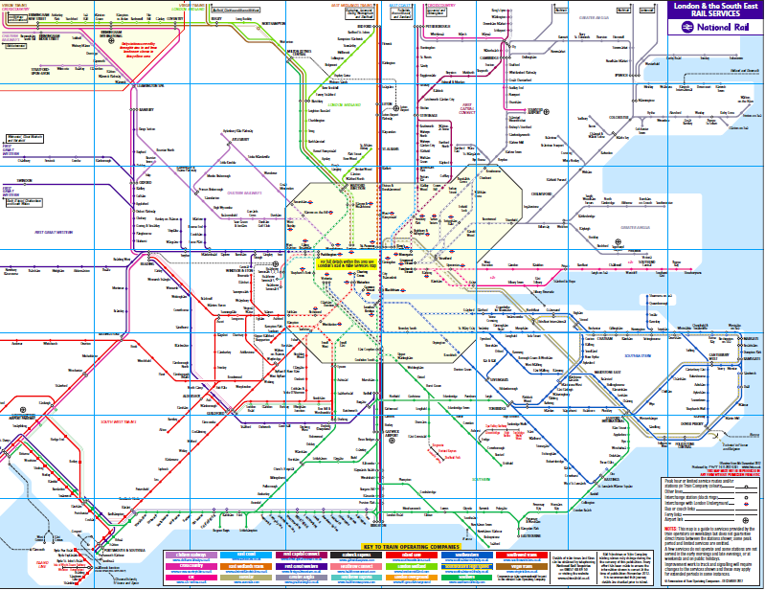
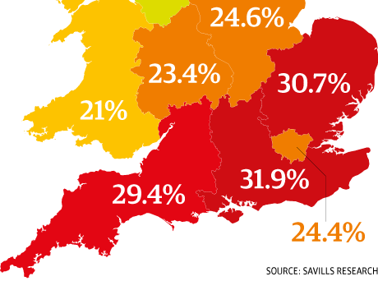
4.1 Godmanchester – Dynamic Impacts: Spillover Effects
1
2
3
4
Has the scheme unlocked new investment in the floodplain?
Based on our understanding of the Godmanchester area and our discussions with local stakeholders, the scheme is unlikely to have facilitated new business or housing developments.
Business developments. We understand from stakeholders that the area of the town protected by the scheme is already heavily developed, leaving no additional space for new developments. It is therefore unlikely that the scheme has facilitated any new business developments in the floodplain. Despite this, the scheme could have reduced the number of businesses that would have shut down as a result of frequent flooding disruption. However, there has been insufficient evidence to assess the degree to which this is the case.
Housing developments. As Godmanchester is a key commuter town for London, Cambridge and Huntingdon (see figure top-right), any new residential development could help to facilitate additional economic activity in these areas. We understand that a new development of 750 residential properties in Godmanchester is in the planning process, but this lies outside the area protected by the scheme. Stakeholders were also unaware of any new residential developments that have been facilitated by the scheme.
What are the spillover impacts of the scheme?
Below we highlight the potential additional spill-over effects, and the likely magnitude of the impact they may have on GVA.
Protecting residential properties may help to support economic activity in Cambridge, Huntingdon and London. On top of actual business disruptions, working hours may also be lost when residential properties are flooded, if homeowners take time away from work to organise repairs or insurance claims for example. Given that Godmanchester is a feeder town for both Cambridge and London (which respectively generate over £14bn and £195bn of GVA each year¹), residential property flooding in Godmanchester could have spillover effects on economic activity in both these cities. The existing appraisal PAR highlights that 542 residential properties are protected by the Godmanchester scheme, suggesting the spillover effects could be significant.
Impacts on house prices may have conflicting impacts on GVA:
Reducing the level of flood risk may increase the value of residential and commercial property (figure lower-right shows projected price changes without FCERM).
However, the upward pressure on house prices may reduce the affordability of new homes, especially if the supply of new housing continues to lag behind demand. This may in turn depress labour supply, which all else equal, could reduce economic activity.
South East rail network
Source: National Rail
House Price Growth forecasts (5 years to 2018)
Source: Savills Research
¹2011 Estimates for Cambridgeshire and Inner London, www.ons.gov.uk/ons/rel/regional-accounts/.../rft-gva-nuts3.xls‎

Slide 19
4.1 Godmanchester – Total estimated impact of FCERM on GVA
1
2
3
4
On top of the first round impacts of £640,000 per annum from the FCERM intervention, the Godmanchester scheme could potentially provide an additional £389,000 - £1.14m in GVA to the local economy from dynamic impacts.
First Round impacts (avoided damage to commercial property) are likely to represent a significant proportion of the total economic benefits generated by the scheme. This is driven primarily by the fact that the average expected damage for a commercial property in Godmanchester is over £400,000, almost double that of residential properties.
As Godmanchester is a key commuter town for Cambridge and London, the scheme is likely to have longer term spillover effects in areas outside the floodplain. This highlights that by protecting key commuter towns at risk of flooding, FCERM investment could support wider benefits for both the local and national economy
Estimated undiscounted annual average (£)
Estimated 10-year GVA impact (£ discounted to PV)
Qualitative assessment
First Round impacts
£640,000
£5.3 million
NA
Dynamic Impacts
£389,000 - £1.14m
£3.23m - £9.52m
The area provides housing which supports high value labour markets in Cambridge and London
Limitations
The business categorisation in the area may not be fully reflective of the make-up of businesses in Godmanchester. This is because the inaccuracy in using both local authority and regional data is likely to be particularly high when it is applied to a small number of businesses. For example, we estimate that around 5 businesses will be professional/technical services firms are located in the floodplain. This may in fact reflect the make-up of businesses in the wider Huntingdon and Cambridge areas, rather than Godmanchester itself.
Stakeholder engagement. We engaged with local councils to provide useful evidence on how businesses may respond to flood risk and how the scheme may impact on new business attraction. Individual businesses were not interviewed.

Slide 20
Godmanchester
Nottingham
Redcar
Sandwich

Slide 21
4.2: Nottingham - Introduction
1
2
3
4
What was the level of flood risk in the Nottingham area?
The city of Nottingham is situated in the Lower Trent Area of the East Midlands Region. The city itself lies on the banks of the River Trent - the low-lying land on both sides of the river makes the city particularly susceptible to fluvial flooding in the event of extreme rainfall. The floodplain surrounding the River Trent in Nottingham contains over 22,000 residential and commercial properties at risk from floods with a 1% (1 in 100) annual probability of occurring.
The Nottingham area has a long record of flooding, with notable floods occurring in the 18th, 19th and 20th centuries. The most significant recent event occurred in 1947 when 15km of highways, 3,000 properties and 86 factories were flooded. This prompted the construction of a long stretch of flood defences in the 1950s. These consisted of a range of walls, embankments and informal defences along the left (north) bank of the river, covering the floodplain across the areas of Sawley, Trent Meadows, Attenborough, Rylands, Meadows and Colwick. A map of the floodplain is provided in the figure top-right.
Hydrological modelling undertaken as part of the appraisal process identified that in the absence of improvements to existing defences, property flooding would occur during events with greater than a 4% (1 in 25) annual probability of occurring.
The FCERM intervention
The improved defences were designed to provide protection to properties from floods with a 1% (1 in 100) annual probability of occurring. Through conversations with the relevant EA teams, we understand the scheme was funded in the most part through Grant in Aid funding, with a small additional contribution from local authorities. We understand that the improvement scheme cost approximately £45m in total.
Details of the specific improvements made under the scheme are provided in the Box on the right.
Left Bank Trent Floodplain in Nottingham
Source: Environment Agency
The scheme involved raising or replacing parts of the existing defences that were below the standard required to provide protection against 1 in 100 year floods, or that were likely to fall below this standard within ten years. This required:
Building new and raising existing flood walls and embankments;
Constructing new flood gates, and making structural improvements to existing canal gates.
Raising road heights;
Implementing sheet pile cut-off to prevent seepage, and improving surface water drainage.
Further details of the scheme can be found in the Nottingham Project Appraisal Report (PAR).

Slide 22
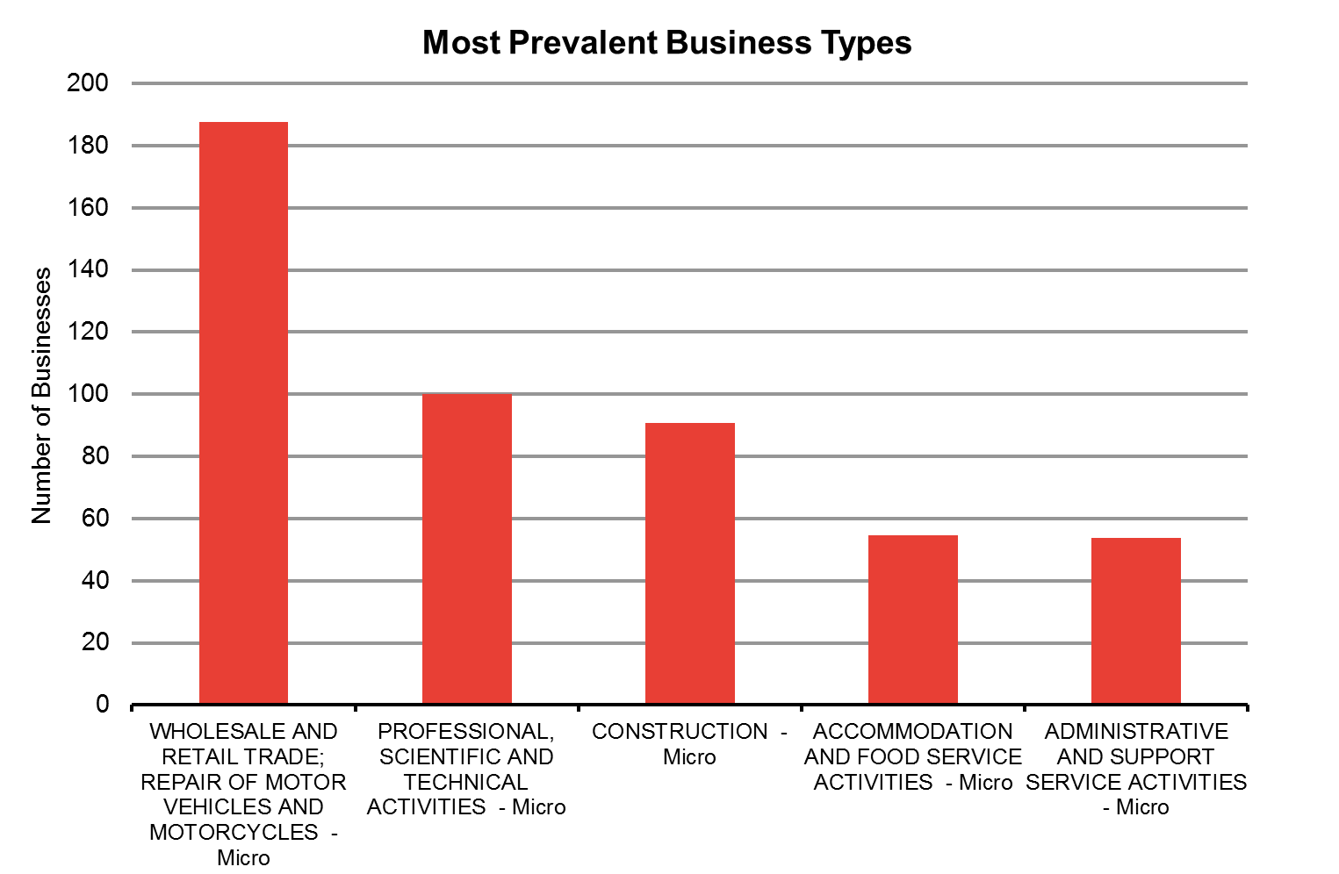
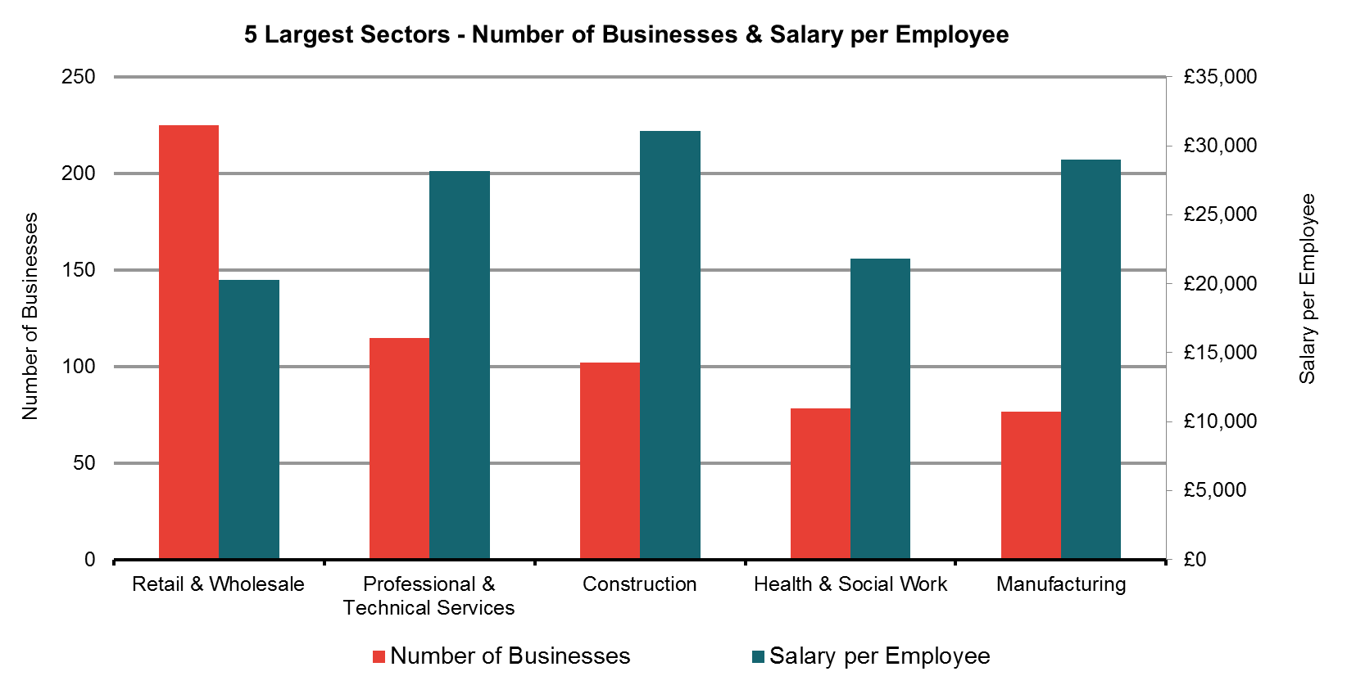
4.2: Nottingham – Business Categorisation
1
2
3
4
Economic activity in the local area
Nottingham is one of the fastest growing cities in the UK. The city is home to companies from a wide range of high-tech industries, housing the headquarters of companies such as E-ON, Siemens, and Experian. The city has a thriving pharmaceutical and biotechnology sector, being made one of the UK's six Science Cities in 2005. BioCity, a joint venture between the cities two Universities, is now the biggest bioscience innovation and incubation centre in the UK. The city also has a large base of public sector organisations, including HM Revenue and Customs and the Driving Standards Agency. The area surrounding the city is mainly rural, with local businesses made up mainly of small independent retailers. In 2012, around £7.6bn of GVA was generated by businesses in Nottingham.
Business categorisation
The number of businesses directly protected by the scheme is estimated using the number of protected commercial properties identified in the existing appraisal (the PAR). This suggested a total number of 1,005 businesses¹. In line Technical Report 1, we used local authority data from the ONS Neighborhood Statistics database to split these 1,005 businesses by industry. As the floodplain spans across Nottingham City, Broxetowe, and Erewash local authority areas, we used the average industry splits across these areas to categorise the businesses. Regional business data for the East Midlands was then used to determine the split of businesses by business size within each industry group. As the data used is not specific to Nottingham itself, the sector composition is therefore indicative; actual types of businesses may vary slightly from our estimates.
Through the business categorisation, we found that:
Small businesses account for a large proportion of the economic activity in the floodplain. ‘Micro’ businesses (less than 10 employees) represent over 80% of all businesses in the floodplain. Large businesses (those with 250 + employees) account for under 1% of the total.
There is a mix of both high and low value sectors. Retail and health & social work businesses make up around 30% of all businesses. However, almost a quarter of businesses are in the construction and professional/technical services sectors, reflecting the growing pharmaceutical and biotechnology sector in the city.
Given the high value that these businesses generate, this is an important driver of economic value in the area.
Source: Frontier Analysis based on ONS & BIS business data
¹This captures the 243 ‘Comm/Ind’ properties identified in the existing appraisal, as well as the 762 ‘Other’ properties. These ‘Other’ properties are included in our figures, as this category is likely to cover public buildings, and other buildings which are likely to provide employment (such as school buildings for example). Working hours will therefore be lost if these buildings are affected by flooding.

Slide 23
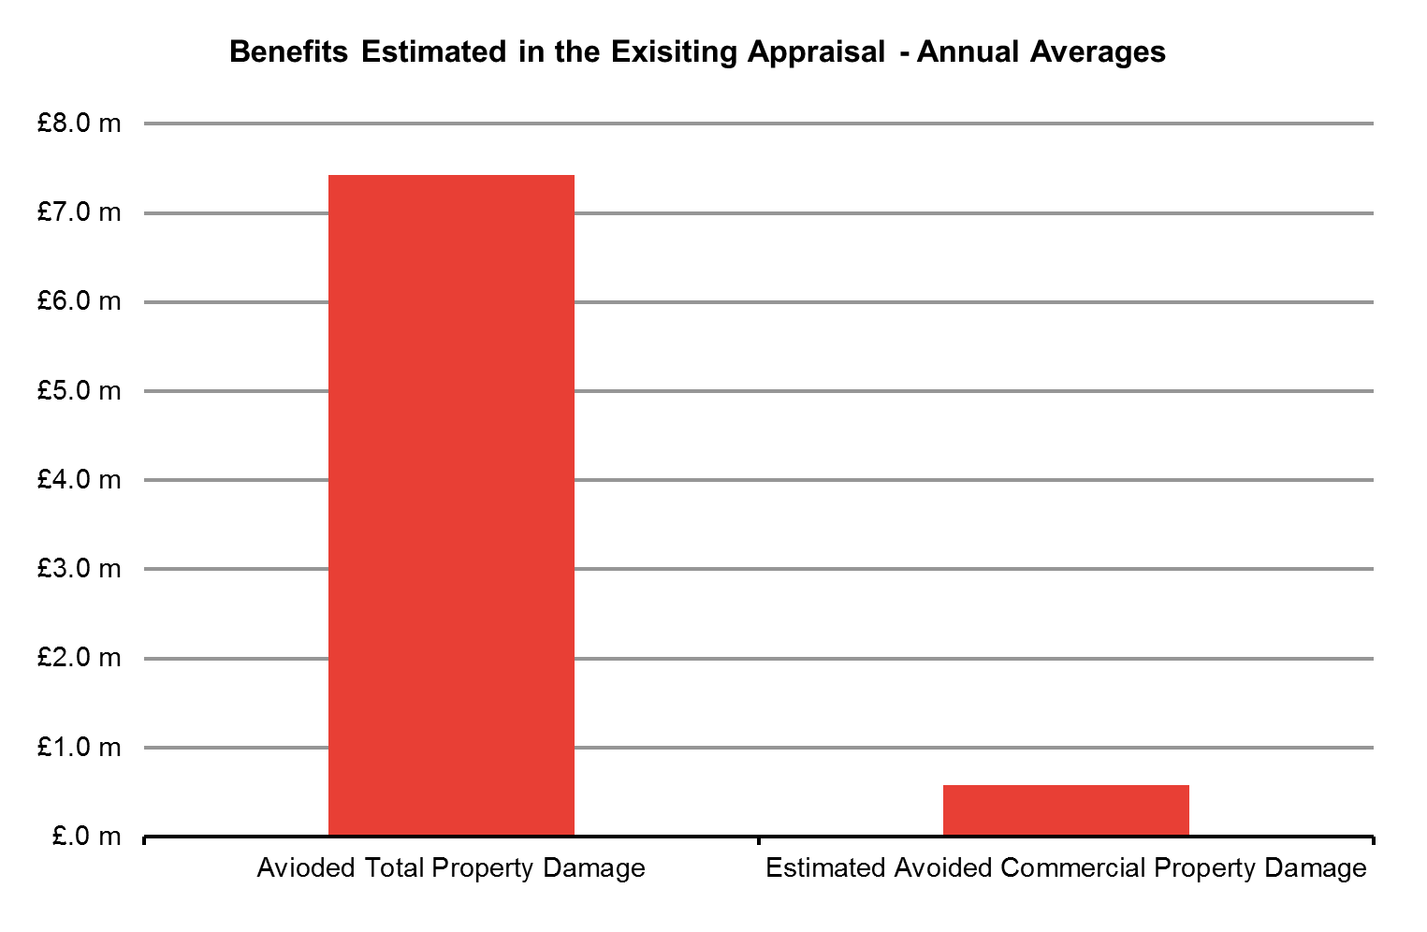
4.2 Nottingham – First Round Impacts
1
2
3
4
What first round impacts does the Nottingham scheme generate?
To ensure that we were taking a proportionate approach, first round impacts are estimated using the EA’s existing economic appraisal (the PAR). As these economic benefits add directly to GVA, we have taken 100% of these benefits in deriving the first round impacts.
The existing appraisal focussed solely on quantifying the avoided damage to properties in the floodplain. As set out in Technical Report 1, the scheme could potentially generate additional GVA through a number of other avenues. For example through avoided damage to transportation and utilities infrastructure, and disruption to agricultural production. However, such benefits were considered negligible in the PAR, and were therefore not quantified explicitly.
The EA’s appraisal estimated the expected damage costs to all types of property under the “Do Nothing” and “Do Something” scenarios (i.e. with and without the intervention). Based on evidence in the appraisal PAR, the EA estimated that the scheme reduces the expected property damage by £214.4m in present value terms over the 100 year lifetime of the asset. As the PAR does not provide separate estimates for different property types, we took a pragmatic approach to estimate the likely avoided damage to commercial properties:
The PAR provides the total number of residential and commercial properties protected by the scheme. This information suggests that 8% of the 12,809 protected properties are used for commercial purposes. In the absence of other evidence, we assume that avoided damage is directly proportional to the number of properties protected. This suggests that the scheme prevents £16.8m (in PV terms) of commercial property damage over the 100 year period.
We then converted this into an average annual figure, using the schedule of social discount rates set out in the Treasury Green Book. Through these calculations, we find that by abating commercial property damage during floods, the scheme generates around £583,000 of additional GVA on an annual basis. This translates to a total present value benefit of around £4.85m when these benefits are considered over the 10-year GVA appraisal horizon. This scale reflects that the scheme protects 1,105 business properties from such floods.
Source: Frontier Analysis based on Environment Agency Project Appraisal Report
Annual Benefits
£583,000
10-Year PV Benefits
£4.85m

Slide 24
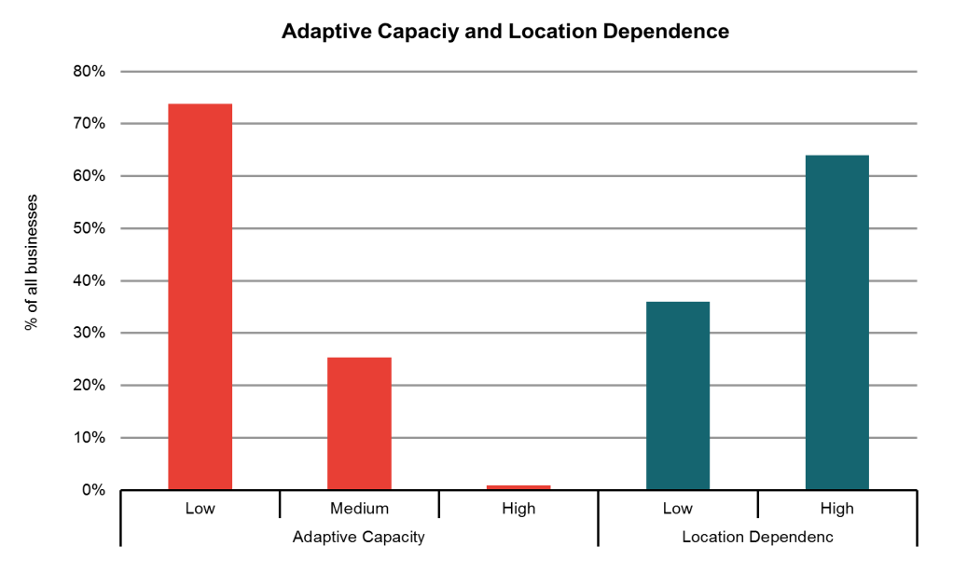
4.2 Nottingham – Adaptive Capacity & Location Dependence
1
2
3
4
Evidence from stakeholders on local business
Our evidence on the adaptive capacity and location dependence of businesses in the Nottingham area was from published studies, and our interviews with stakeholders from local councils and the local Chambers of Commerce (a more detailed summary of stakeholder evidence for each case study area is provided in Annex 1). We found that overall, stakeholder evidence supports the published literature.
The evidence suggests that large businesses, as well as medium-sized businesses in sectors where risks are dealt with on a day-to-day basis (for example in regulated industries), would be likely to adapt because of their relatively high adaptive capacity. Small businesses on the other hand are likely to have much lower levels of adaptive capacity. This is driven by a number of different factors, including financial constraints, the lack of awareness of flood risk and the possible ways to adapt, and the restrictions from leasing/renting their commercial properties. The construction of a new tramlink in the city affecting a number of businesses was noted as a reason why this, and not flooding, was a priority for businesses’ attention.
Similarly, the evidence suggests that a large number of small businesses, given their reliance on strong local connections, are likely to have high location dependence.
What is the likely Adaptive Capacity and Location Dependence of local businesses?
To determine the adaptive capacity and location dependence of each business in the floodplain, we used our preliminary ‘business look-up table’ (see Annex 2). This illustratively suggests the likely level of adaptive capacity and location dependence for each type of industry and size of business, based on published evidence and our stakeholder engagement. This suggests a large number of businesses are likely to be have low levels of adaptive capacity, and high levels of location dependence. This is discussed further in the Box on the right. Our analysis suggests:
74% of businesses in the Nottingham flood plain are likely to have low adaptive capacity and only 1% are likely to have high adaptive capacity.
Around 64% of businesses are likely to have high location dependence.
Source: Frontier Analysis
The low levels of adaptive capacity are driven by the large proportions of ‘Micro’ businesses in the area. We estimate that around 90% of these businesses are likely to have low adaptive capacity. On the other hand, the majority (around 85%) of large businesses are likely to have high adaptive capacity.
Firms in the construction sector in the area, as well as those in regulated industries, are likely to have the capacity to adapt. In particular, construction firms (which represent over 10% of the businesses in the floodplain based on our estimates), are likely to consider flood risk as part of their broader business risk assessment.
The high levels of location dependence are driven by the high proportion of small businesses in the retail, professional, scientific & technical services, and accommodation sectors in the local area. In particular, bio-technology firms are likely to have strong preferences over locating in the area for operational reasons, given the cluster of similar businesses in the floodplain and accessed to skilled labour.

Slide 25
4.2 Nottingham – Business Responses
1
2
3
4
Evidence from stakeholders on business responses to flood risk
As well as gathering evidence on the adaptive capacity and location dependence of businesses in Nottingham, we also asked a small number of business representative stakeholders about the likely responses of different types of businesses to flood risk in the local area. This is again summarised in more detail in Annex 1.
The evidence indicates that large businesses tend to have a large fixed asset base that makes moving particularly costly. Smaller businesses would be unlikely to have the funds to re-locate, and would be particularly reliant on local connections for business. No stakeholders we spoke to were aware of any businesses that had moved as a direct result of flooding. The evidence also suggests that the majority of businesses in Nottingham will have little ability to adapt given their size and resources available, and are therefore most likely to suffer significant damage to commercial and productive capabilities in the event of a flood.
Likely business responses
To determine the likely responses of each business in the floodplain, we used the preliminary ‘business look-up table’. This is applied to the illustrative business characterisation of the area. The look-up table attempts to indicate the likely responses (for example, staying and adapting or staying and doing nothing) of each type of business, given their level of adaptive capacity, location dependence and the responses of stakeholders in the case study areas.
Given the evidence that was available to us, we were unable to assess the extent to which some businesses would shut down or re-locate as a result of flooding. We therefore assess the impact of this only as a sensitivity test.
To capture the uncertainty around how businesses may respond to flood risk, we developed a range based on the percentage of businesses with medium adaptive capacity that adapt.
Given the low levels of adaptive capacity of many businesses, many of the businesses protected by the scheme would not be likely to adapt in response to flood risk. More details are provided in the Box below. We estimate:
7-20% of businesses are likely to stay and adapt. This range reflects our assumptions on the number of high and medium adaptive capacity that adapt.
80-93% of businesses are likely to stay and do nothing. This range reflects sensitivity tests on the number of businesses that have low adaptive capacity and high location dependence.
As part of our analysis, we assume that those taking adaptation action in the absence of the FCERM intervention, would also choose to adapt if the scheme was implemented, with the only difference being the level of adaptation made. Businesses may adapt to a lesser degree to reflect the new lower risk of flooding.
Key messages from business responses:
7% - 20% of businesses are likely to adapt. This means that of the 1,005 businesses in the floodplain, between 75 and 200 businesses are likely to protect themselves from flooding in some way.
A large proportion of those adapting are likely to be large and medium-sized businesses. Around two thirds of those likely to adapt are either medium or large businesses. We estimate that the majority (90-100%) of large businesses would be likely to take some form of adaptation action.
Businesses in Nottingham which are most at risk of flooding, are generally small, wholesale and retail, construction, professional businesses with low flood thresholds. These businesses generally do not have the capabilities to adapt.
As a key part of the local economy is the bio-technology hub, we consider the impact of medium-sized businesses in the professional, technical and scientific service sector re-locating in the absence of the scheme as a sensitivity test.

Slide 26
4.2 Nottingham – Dynamic Impacts: Direct Effects
1
2
3
4
What is the likely dynamic impact of business responses to flooding?
Using the estimated range of business responses, we can explore the likely wider impacts of flooding and FCERM. In the absence of FCERM intervention, evidence suggests that disruption to business activity could last many weeks. Based on available evidence, we assume that without the intervention, a business could be disrupted for around 16-24 weeks because of flooding and just 2-4 weeks with the intervention. The ranges in the impacts we outline reflect both this variation in business disruption due to level of flood risk, and the variation in business response of businesses with medium adaptive capacity. Estimated impacts are:
For businesses that stay and do nothing, the dynamic impact we estimate is based on the expected annual disruption costs they face as a result of their business operations being interrupted in the event of a flood. Assuming that businesses temporarily cease operations for a period of 16-24 weeks in the absence of the FCERM intervention, we estimate a total loss in productive working hours equivalent to £3.35m – £9.88m per annum. By reducing the level of flood risk with FCERM and the likely length of business disruption to 2-4 weeks, the equivalent expected annual cost with the intervention could fall to £206,000-£210,000. The reduction brought about by the FCERM investment could therefore be estimated to be around £3.14m-£9.67m on an annual basis. This equates to an estimated increase in GVA of approximately £26.1m-£80.4m over the ten-year GVA appraisal period.
When businesses stay and adapt, we assume that they adapt ‘optimally’ given the risk of flooding they face i.e. the reduction in expected annual damage and disruption costs is equal to their investment in adaptation. The implementation of FCERM reduces the business’s need to invest in adaptation. Since the funds freed up for investment in other activities would provide broadly comparable returns to those that they would have provided when invested in adaptation, the value of the damage avoided by adaptation provides a reasonable approximation of the GVA impact of the investment of the funds freed up and is an estimate that more readily available (from the FCERM-AG) for use in the analysis.
The prevalence of small and micro sized businesses in the local area means that the majority of the GVA impact comes from businesses being unable to respond to flood risk on their own. In addition, as we have already noted, there is insufficient evidence to be able to estimate how many businesses may move or shut down. As a result, these impacts are not included in our headline estimates of GVA. However, in order to illustrate the potential scale of the impact on GVA, we conducted sensitivity analysis:
If businesses re-locate out of the floodplain, the total value of the productive hours generated by these businesses’ activities is lost to the local economy. If 2-5 of the estimated 14 medium-sized professional, technical and scientific service businesses where to re-locate in the absence of the scheme, where FCERM prevents this, this would be equivalent to around £7.3-18.3m of local GVA retained in the local economy.
If businesses shut down in response to flood risk, the total value of the productive hours generated by these businesses activities is again lost. Assuming that between 1% and 5% of the estimated 494 businesses with low adaptive capacity and high location dependence were to shut down in the absence of the scheme, where FCERM prevents this, this would be equivalent to around £0.8-4.2m of annual GVA¹ retained in the local economy.
Key Messages
Most of the dynamic impacts are driven by micro and small businesses staying and doing nothing. These businesses account for over 90% of the incremental annual impact. This highlights the significant longer term value of FCERM investment in areas were a large proportion of businesses would fail to protect themselves from flooding in the absence of intervention.
Although unlikely, a small number of high-value businesses re-locating in response to flood risk can have a significant impact on GVA. Public and local investment in FCERM will therefore be valuable in such areas.
¹This is a sensitivity test. As outlined in Technical Report 1, businesses with low adaptive capacity and high location dependence will be those most likely to shut down in response to flood risk.

Slide 27
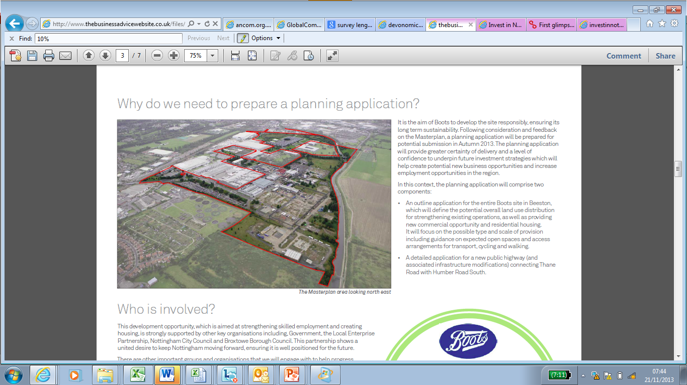
4.2 Nottingham – Dynamic Impacts: Spillover Effects
1
2
3
4
Has the scheme unlocked new investment?
We understand that the scheme has facilitated the development of the ‘Boots Enterprise Zone’ within the floodplain (see figure top-right). The zone is solely owned by the Boots Alliance Group, and plans to provide up to 200,000 square metres of additional business space, on top of the 350,000 sqm of space already occupied by existing Boots developments. We understand that the existing development employs over 8,000 people on the site. As planning consent is generally not given to sites at high risk of flooding, we are told it would have been extremely difficult for the zone to get the go-ahead if it wasn’t for the flood defence scheme.
As highlighted in more detail in the Box below, we understand that the additional 200,000 sqm of business space will be used to create a new UK centre for innovation and product development in the health, beauty and wellbeing sector. This could make a substantial additional contribution to GVA in the Nottingham area:
From the available information, we estimate that the existing Boots development supports 1 job for every 45 sqm of business space. Assuming that the new developments on the site generate 50-100% of these jobs per sqm figure, the additional business space could generate approximately 2,250 - 4,500 new jobs in this sector within the floodplain.
Given the space is likely to be used to establish a new bioscience incubator, we then apply the average salary per employee in the Professional, Scientific, and Technical services sector in the East Midlands to the estimated number of jobs created. This suggests that the zone could generate an additional GVA of up to £60 - 121m in the local area on an annual basis
Boots Enterprise Zone
Source: Nottingham Enterprise Zone – Boots - Masterplan
Around £60 - 120m
Potential GVA facilitated by the scheme per year
The Enterprise Zone site is located in the Beeston area of the city, and sits on the border of the Nottingham City Council and Broxtowe Borough Council areas. Boots have occupied a 350,000 sqm area of land on the site since 1927. However in addition, the Zone plans to provide:
200,000 sqm of additional business space. These will include offices, research and light industrial properties. Business locating on the site will enjoy a number of ancillary benefits, including tax breaks and lower business rates.
Brownfield land for the development of 675 new homes.
21 hectares of green recreational space.
Since the site was awarded Enterprise Zone status, the Boots Alliance Group has announced a collaboration with BioCity, the UK’s leading bioscience incubation company, to establish a new business incubator called MediCity on the site, focused on health and wellness.
Source: Nottingham Enterprise Zone – Boots - Masterplan

Slide 28
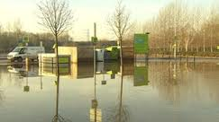
4.2 Nottingham – Dynamic Impacts: Spillover Effects
1
2
3
4
What are the additional spillover Impacts of the Scheme?
Information gathered during our engagement with stakeholders suggests that the scheme could have a number of additional spill-over effects. Given the data we have available, it was not possible to quantify the impact of these effects on GVA. However, the available information suggests the following effects could be likely.
Increased agricultural yields. Stakeholders highlighted that the reduction in flood risk has allowed for more efficient crop rotation on agricultural land, helping to increase yields. It has also facilitated the production of higher value crops such as sugar beet. However, given that agricultural businesses make up only a small proportion of businesses in the floodplain, the magnitude of this effect on GVA is likely to be small. As with avoided commercial property damage, impacts on agricultural production and yields would be measured under the standard appraisal guidance (and so would have been re-presented as a local GVA impact here). The fact that these impacts were not measured as part of the existing project appraisal also suggests that any impact on GVA is likely to be negligible.
Business interdependency. Given supply-chain links between businesses (see figure top-right), one business being disrupted in the event of flooding may have knock on effects on other otherwise unaffected businesses, both within and outside the floodplain. These interdependencies could be significant, particularly for those businesses with long or complex supply chains.
Disruption to infrastructure may impact on the effectiveness of adaptation in preventing business disruption. Even if a business protects itself against flooding, disruption to for example transport links could still lead to business disruption, as staff could find it difficult to reach the place of work. One stakeholder mentioned that the Queens Park ‘Park & Ride’ (see figure lower-right), used by employees at the two city hospitals and major nearby industry including the Experian headquarters, would be flooded even with the Nottingham scheme in place. As a result, working hours in these institutions could still be lost, irrespective of whether these businesses take adaptation action.
The Enterprise zone could facilitate further increases in economic activity through its housing development. Providing additional housing helps to increase the stock of labour in the local area. However, we understand these properties will house the additional workers in the enterprise zone, so this effect is likely to be captured by the £121m figure we have estimated.
Interdependency across the supply chain
The Queens Park ‘Park & Ride’ in December 2012
Source: BBC Website

Slide 29
4.2 Nottingham – Total estimated impact of FCERM on GVA
1
2
3
4
The Nottingham scheme could potentially provide around £3.1-£9.7m additional GVA per annum to the Nottingham local economy, on top of the first-round impacts. A further £60-120m is also estimated to potentially be facilitated by the intervention in the form of unlocked investment.
A significant proportion of the economic benefits are dynamic impacts. This is driven primarily by the large number of businesses in Nottingham that are unlikely to adapt in response to flood risk, and that as a result, would be likely to be severely disrupted by flooding in the absence of the Nottingham scheme.
The scheme highlights the importance of FCERM investments in unlocking new business developments in flood-prone areas that can have a significant impact on the local economy. Through the supply chain, business not directly affected by the flooding could also benefit.
Estimated undiscounted annual average (£)
Estimated 10-year GVA impact (£ discounted to PV)
Qualitative assessment
First Round Impacts
£583,000
£4.85 million
NA
Dynamic Impacts
£3.1m-£9.7m
£26.1m-£80.4m
£60 - 120million potential new developments facilitated by the intervention
Specific limitations
The business categorisation is based on local authority and regional business data. The actual make-up of businesses in the floodplain may differ from what we have estimated here. As certain types of business are more valuable than others, this is may impact on the GVA estimates.
The scheme could have a number of spill-over effects that could materially impact on GVA, but many cannot be quantified robustly. As we have identified, the scheme is likely to have various additional impacts on GVA, in particular through ensuring businesses not directly at risk of flooding are not disrupted during floods, and by helping to improve the effectiveness of businesses own adaptation actions. However, these impacts are inherently difficult to quantify given the data available. As these impacts could be potentially large, the GVA impact we estimate may be a conservative estimate of the true impact the scheme may have.

Slide 30
Godmanchester
Nottingham
Redcar
Sandwich

Slide 31
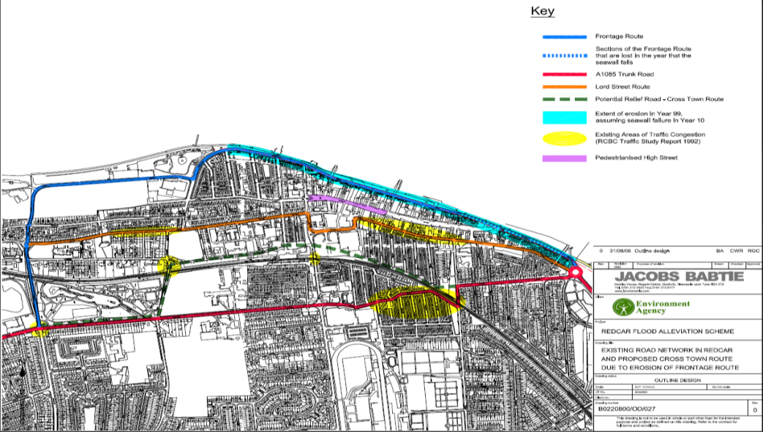
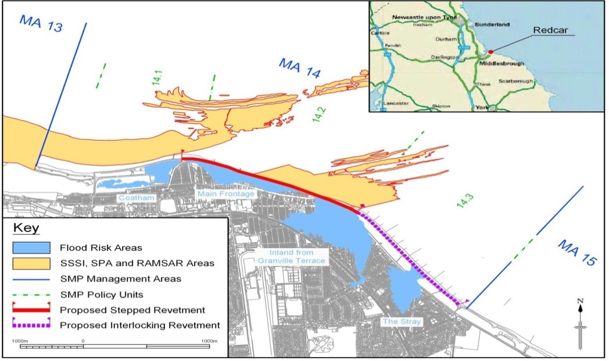
4.3: Redcar - Introduction
1
2
3
4
What was the level of flood risk in the Redcar area?
Redcar is a coastal town located in North East England to the east of Middlesbrough and south of the Tees Estuary. It is an important local tourist destination with over one million visitors annually and had flood risk of 1 in 10 years prior to FCERM intervention. Redcar has suffered a number of storm events which have caused damage to the seawall requiring significant repairs (1909, 1913, 1925, 1953, 1996, 2008).
The intervention
The proposed FCERM scheme is located along a 2.7km stretch of coastline which fronts Redcar town centre, with the Esplanade and the Stray the main areas of focus (see figure top-right). The flood plain (see figure lower-right) is an intensively developed urban area with 209 commercial and industrial commercial properties at risk of flooding and a further 98 at risk of coastal erosion. Following a feasibility study in 2003, it was recognised that the only viable option for FCERM was to defend the Redcar frontage and maintain the groynes and seawall at the Stray. Investment for the Redcar Coastal Defence has been to provide a 1 in 300 standard of protection. The intervention includes replacement of the seawall and works at the seafront. This level of protection will be maintained for 50 years. There are some small variations in protection for different areas along the seafront depending on building use. Buildings which are not currently in use have been awarded a lower level of protection. The FCERM investment was provided by the EA and Redcar Council Funding to the value of £22million. This supported flood defence and enhanced landscape by the seafront. This investment in FCERM is part of a wider regeneration Master Plan to support Redcar business development.
Redcar Coastal Flood Alleviation Scheme
Source: Economic Appraisal Report, June 2009)
Redcar Coastal Flood Risk Area
Key points on investment in the intervention:
The “preferred” option implemented reduced the risk of flooding from 1 in 10 to 1 in 300.
Investment provided by the Environment Agency and Redcar Council was £22million.
The flood defence scheme plays a wider role in supporting the Redcar regeneration Master Plan.
Source: Economic Appraisal Report, June 2009)

Slide 32
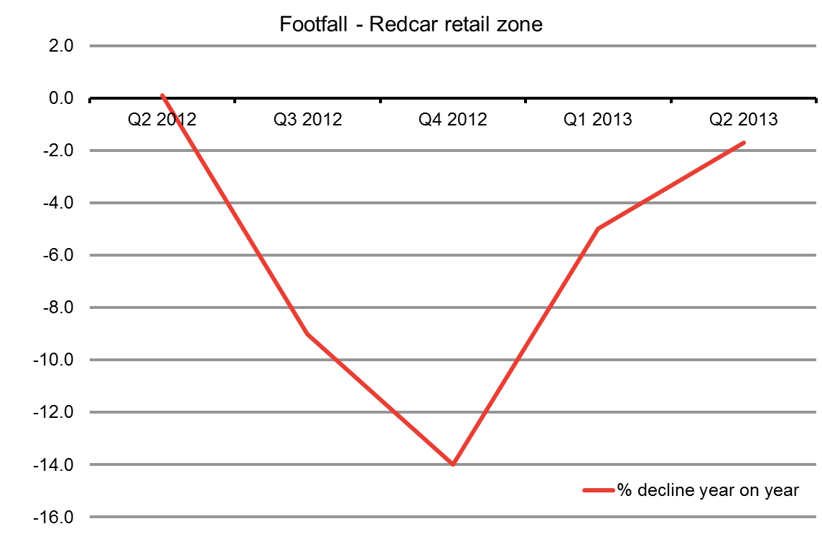
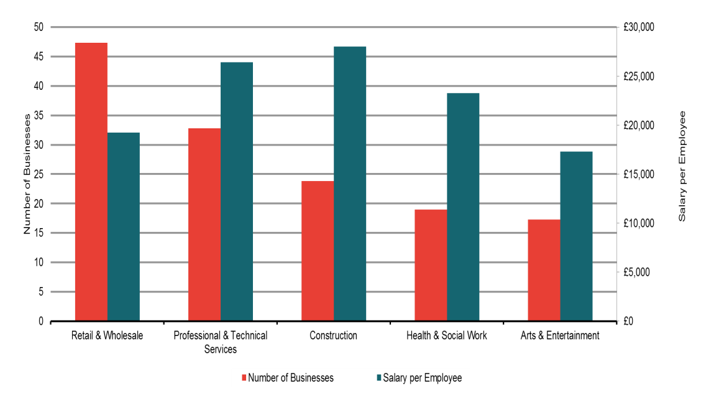
4.3 Redcar – Business Categorisation
1
2
3
4
Economic Activity in the Local Area
Redcar is a typical English seaside town which has seen recent dips, as in 2012, in footfall to the retail part of the town, but has since risen (see figure top-right). There are a variety of types of businesses in the local area, though they are generally small, locally owned, and serve the tourist trade - restaurants, cafés, leisure facilities and amusements are prevalent on the seafront. A number of these businesses have started to fall into disrepair or abandonment given the risk of flooding. The seafront area is also used by fishermen for storing boats and for selling fish. There is also small a number of large local industries in the area: Tata steel, Wilton Power Station and PD Ports provide significant local employment.
Redcar is heavily reliant on tourism and although the town on average has about 28,000 visitors a week, and approximately 1 million visitors a year, this sector has seen significant decline in business over recent years. Redcar has over an estimated one million visitors per year. Redcar beach, the Esplanade and the race-course are central tourist attractions in the area and their threat from risk of flooding is significant given their proximity to the seafront. The racecourse alone attracts 65,000 visitors to Redcar each year.
Business categorisation
The existing appraisal identified a total of 307 commercial properties at risk. 209 commercial and industrial properties at risk of flooding under the “Do Nothing” option and 98 businesses at risk from asset erosion due to coastal erosion. The data (see figure lower-right) indicate that:
Retail and wholesale businesses are most prevalent in the Redcar economy, but are generally of lower GVA businesses than the professional and technical service businesses in the area. This data picks up the prevalence of shops along the Redcar seafront.
Of the 307 businesses at risk of flooding and coastal erosion, 247 of the businesses are micro, 59 are small and only 2 are a large business. This again demonstrates the importance of small, locally owned businesses along the Redcar seafront. The large businesses likely capture the presence of seafront industries..
Source: Redcar and Cleveland Borough Council data
Source: Frontier analysis based on ONS and BIS data

Slide 33
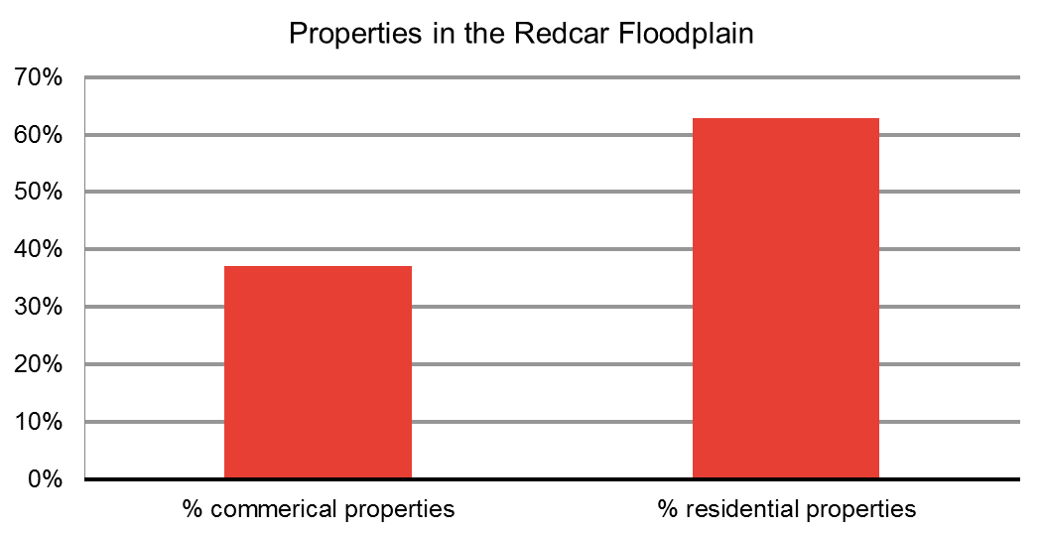
4.3 Redcar – First Round Impacts
1
2
3
4
What first round impacts does the Redcar scheme generate?
Under the EA’s project appraisal of the Redcar scheme, the cost of damages were assessed based on the length of time properties would be expected to be flooded (more or less than 12 hours) and the depth of the floods.
In total, 307 commercial and industrial properties are at risk (209 from flood risk, 98 from coastal erosion). The impact of defences to mitigate coastal erosion are included alongside flood defences given the significant role they play in the Redcar area, and are treated in the same manner as flood defences. Local commercial fishing facilities were also at risk of flooding, along with significant local transport and utilities infrastructure. Based on the information in the EA’s project appraisal, comparing the estimated damage costs in the “do nothing” scenario with the “do something” FCERM intervention, the PV damage to commercial properties shows:
From the EA’s project appraisal, the PV estimates of the damage costs under the “Do Nothing” scenario (without the FCERM intervention) were £206.3million over the 100 year lifetime of the asset. Of this, 28.1%, or £58 million, is accounted for by expected damage to commercial and industrial properties from risk of flooding and a further £18mllion for damage from coastal erosion. In total therefore, £76million (36.9%) is accounted for by expected damage to commercial and industrial properties.
Comparing the estimates of expected damage to properties in the “do nothing” scenario, with damage expected under the scenario with the FCERM intervention – the “do something” - the avoided damages to commercial property from the risk of flooding (209 properties) is £2million on an undiscounted annual basis. This annual average is a GVA effect. When converted to our ten-year GVA present value, this is £16.7million.
Including the 98 properties at risk of coastal erosion (a one off loss) as well, the total avoided damages to commercial property, from the FCERM investment are estimated to be £2.6m on an annual basis. This is a GVA effect and when converted to our ten-year GVA present value, this is £21.9million. These are considered in more detail later.
Source: Based on data in the Project Appraisal Report
Annual GVA
£2.0m
10 year PV GVA
£16.7m
Calculation of annual averages account for the variations in discount rates outlined by the Green Book, across the original 100 year appraisal period. Calculation of ten-year GVA present value uses standard discount rates in Excel of 3.5%.

Slide 34
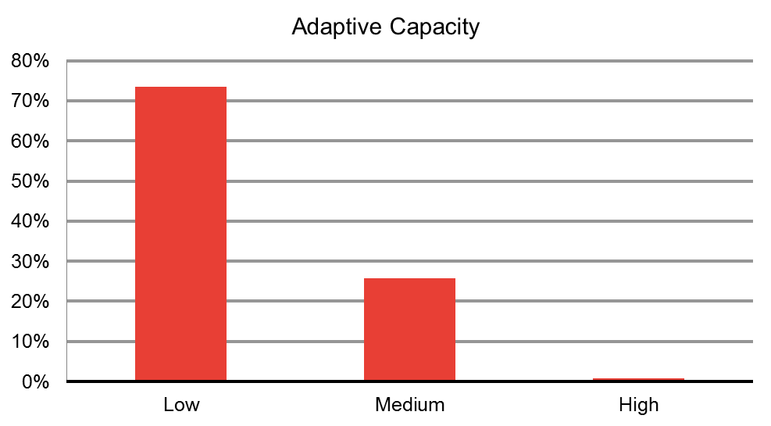
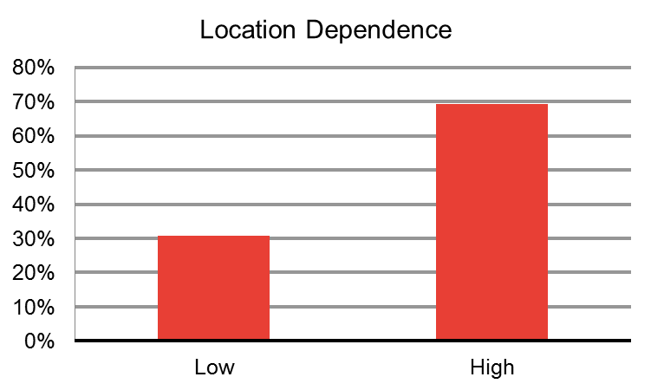
4.3 Redcar – Adaptive Capacity & Location Dependence
1
2
3
4
What is the likely Adaptive Capacity and Location Dependence of local businesses?
Published evidence indicates that small and micro sized businesses are less likely to have medium or high adaptive capacity owing to their information and resource constraints. This is supported by stakeholder evidence. Similarly, the evidence indicates that a large number of businesses in the Redcar area are locally owned. Given their small size, and strong local connections, they are likely to have high location dependence. This combination of low adaptive capacity and high location dependence, indicates that these businesses are likely to stay and do nothing in the face of flood risk. Furthermore, evidence from the existing appraisal suggests that some local businesses could risk having to shut down given the likely impacts in the event of a flood. Properties directly on the seafront which have suffered repeated flood damage have reportedly been abandoned rather than invested in.
Their small size, sector composition and low threshold to withstand flooding (as indicated in the original Project Appraisal Report), means that businesses in the Redcar floodplain are likely to have low adaptive capacity. We estimate:
73% of businesses in the Redcar flood plain are likely to have low adaptive capacity and only 1% are likely to have high adaptive capacity.
69% of businesses in the Redcar flood plain are likely to have high location dependence and 31% are likely to have low location dependence.
Source: Frontier analysis
73% of businesses are likely to have low adaptive capacity
69% of businesses are likely to have high location dependence
Source: Frontier analysis

Slide 35
4.3 Redcar – Business Responses
1
2
3
4
Evidence from local business representatives
Qualitative research supports the data that businesses in the Redcar area are unlikely to move or adapt in response to the risk of flooding.
Evidence from local business representatives supports the data which suggests that small local businesses in Redcar are not able to adapt in response to flood risk and are instead likely to stay and do nothing, or in the face of repeated flooding, shut down.
Some local businesses report a generally low level of awareness around risk of flooding – they report that there are no flood warnings and that businesses are responsible for making themselves aware through watching local weather forecasts. Local businesses also report difficulties in affording the cost of insurance available.
As part of our analysis, we assume that those taking adaptation action in the absence of the FCERM intervention, would also choose to adapt if the scheme was implemented, with the only difference being the level of adaptation made. With FCERM, businesses may adapt to a lesser degree to reflect the new lower risk of flooding and coastal erosion.
Given the composition of businesses in Redcar being small, micro and generally locally owned, businesses are most likely to stay and adapt, or stay and do nothing. However, it is also possible that businesses opt to move or to shut down. There is an absence of evidence on the potential scale of this effect so we use illustrative sensitivity tests.
If we assume that 1-5% of businesses that have medium to high adaptive capacity and low location dependence move in the absence of FCERM, this would be equivalent to 1 business leaving the Redcar local economy. FCERM could avert this impact.
If we assume that 1-5% businesses that have low adaptive capacity and high location dependence shut down completely without FCERM, this would be equivalent to 2 of Redcar’s business shutting down.
Likely Business Responses
To determine the likely responses of each business in the floodplain, we again used the preliminary ‘business look-up table’. We apply this to the business characterisation of the area. The look-up table defines the likely responses (either staying and adapting or staying and doing nothing) of each type of business, given their level of adaptive capacity, location dependence and the responses of stakeholders in the case study areas.
To capture the uncertainty around exactly how businesses may respond to risks, we derived a range of possible business responses. This is done by varying the percentage of businesses with medium adaptive capacity that are likely to adapt, in line with the assumptions proposed in Annex 2.
This combination of low adaptive capacity and high location dependence, results in most businesses being unable to adapt or move, in the face of flood risk. On the basis of our assessment, of commercial and industrial businesses in Redcar at risk of flooding or coastal erosion,
7-20% of businesses are likely to stay and adapt. This range reflects the sum of all businesses that are likely to have high adaptive capacity plus 25% - 75% of those with medium.
80-93% of businesses are likely to stay and do nothing. This range is informed by testing sensitivities on the range of businesses that have low adaptive capacity and high location dependence.
Key points on business responses:
Redcar businesses which are most at risk of flooding and coastal erosion, are generally small, wholesale and retail, construction, professional businesses with low flood thresholds. These business generally do not have the capabilities to adapt.
7-20% of businesses are likely to stay and adapt. This means that we would estimate between 21 and 61 businesses are likely to protect themselves from flood and coastal erosion risk.
80-93% of businesses are likely to stay and do nothing. This means that between 245 and 286 businesses would not be likely to adapt to flood or coastal erosion risk.

Slide 36
4.3 Redcar – Dynamic Impacts
1
2
3
4
What are the likely dynamic impacts?
Using the estimated range of business responses, we can explore the likely dynamic impacts of flooding and FCERM. In the absence of FCERM intervention, based on a review of available evidence we assume that a business could be disrupted for around 16-24 weeks because of flooding and 2-4 weeks with the FCERM intervention.
As a result of the majority of businesses being small with low adaptive capacity and high location dependence, the intervention in Redcar could bring about significant increases in GVA for the local economy.
For businesses that stay and do nothing, the dynamic impact estimated is based on avoided expected annual disruption costs faced as a result of business operations being interrupted due to flood risk. Assuming that the business disruption from flooding is 16-24 weeks in the absence of the FCERM intervention, we estimate a total loss in productive working hours of £1.6m - £5.5m per annum. Reducing the level of flood risk and the likely length of business disruption to 2-4 weeks ,the equivalent expected annual cost of the intervention could fall to £15,400-£15,300. The reduction brought about by the FCERM investment could therefore be estimated to be around £1.8m-£5.5m on an annual basis This equates to an estimated increase in GVA of approximately £15.2m-£45.7m over the ten-year appraisal period relative to the case without FCERM.
When businesses stay and adapt, we assume that they adapt ‘optimally’ given the risk of flooding they face i.e. the reduction in expected annual damage and disruption costs is equal to their investment in adaptation. The implementation of FCERM reduces the business’s need to invest in adaptation. Since the funds freed up for investment in other activities would provide broadly comparable returns to those that they would have provided when invested in adaptation, the value of the damage avoided by adaptation provides a reasonable approximation of the GVA impact of the investment of the funds freed up and is an estimate that more readily available (from the FCERM-AG) for use in the analysis.
Most of the GVA impact is likely to be driven by micro and small businesses staying and doing nothing – accounting for 57% and 43% of the incremental annual impact respectively.
The prevalence of small and micro sized businesses in the local area means that a driver of the impact on GVA derives is businesses being unable to respond to flood risk on their own. In addition, there is insufficient evidence to be able to estimate how many businesses may move or shut down because of flood risk.
However, to illustrate the potential scale of impact on GVA, we can adopt the sensitivities previously outlined.
If 1-5% of businesses move out of the Redcar local economy in response to flood risk without FCERM, where FCERM is able to prevent this, this would be equivalent to £0.2m - £1m per annum retained in the local economy.
If 1-5% businesses in Redcar shut down due to flood risk, in the absence of FCERM intervention then where FCERM is able to prevent this, it would be equivalent to £0.2m-£1m per annum retained in the local economy.
Coastal erosion
The Environment Agency has estimated that 98 commercial properties are at risk of coastal erosion in Redcar. On the basis of stakeholder evidence, we assume businesses at risk of coastal erosion are likely to be 35% retail; 15% accommodation and food; and 50% arts, entertainment and recreation. Further evidence indicates that businesses at risk of are also likely to be micro (1-10 employees). Accounting for these factors, we can illustrate the potential impact of coastal erosion on the Redcar local economy, by considering “what if” scenarios. These ask “what if” those businesses that would otherwise cease activity in Year 1, Year 5 or Year 10 are able to continue their business activity as a result of FCERM.
If all business would otherwise have ceased activity in Year 1, the PV of total retained economic activity is £70.2m.
If all business would otherwise have ceased activity in Year 5, the PV of total retained economic activity is £39.2m
If all business would otherwise have ceased activity in Year 10, the PV of total retained economic activity is £5.9m.
Annex 6 provides more detail on the Coastal Erosion Methodology.

Slide 37
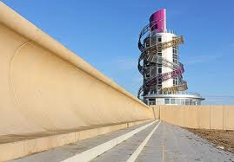
4.3 Redcar – Dynamic Impacts: Spillover Effects
1
2
3
4
Has the scheme unlocked new investment?
Stakeholder evidence suggests further developments have been facilitated by the investment in the flood defences: four new businesses have emerged in the town since the completion of the flood defences and 7 new more properties are under construction. This contrasts with the declining economic activity before the flood defence and regeneration investment. If we assume that these businesses are more of the most common type of business in the Redcar area (micro wholesale and retail) then this would be equivalent to about 55 jobs and an estimated £1m GVA per annum in the Redcar economy having been facilitated in some way by the investment in FCERM.
What are the additional spillover impacts of the scheme?
The investment in FCERM by the Environment Agency and Redcar Council is part of an overall regeneration Master Plan (£100m) for the local area. The aim of the plan is to encourage start ups and attract businesses. This Master Plan investment fits into the wider development of the Tees Valley Enterprise Zone (EZ). Redcar’s investment in FCERM allows for the borough to participate in the Teesside EZ, benefitting the local economy significantly over the longer-term. Alongside the flood defence investment, there has been increasing investment in local business spaces and enterprise activities. These include:
The “Redcar Beacon” vertical pier is part of the flood alleviation scheme, with tenant and commercial spaces to let in the tower (£1m EU funding, £1.5m Redcar Council)
A commercial business to business services centre (£3.5m EU Funding and £5m Redcar Council)
A centre with services for young people (£5m Big Lottery Fund)
A new town centre, with town hall leisure centre and 44 new offices spaces (£30million) .
Alongside long-term investment, here has also been a reported increase in tourist numbers in Redcar since the opening of the Esplanade. This is likely to support seafront hospitality businesses and arts and leisure businesses further.
Figure 3: Redcar Coastal Flood Risk Area, Economic Appraisal Report, June 2009
The “Redcar Beacon” is a central part of the flood alleviation scheme, worth £2.5million
It is possible that up to around 55 new local jobs have been created as a result of new business development since investment in FCERM. If so, this would be equivalent to an additional £1m GVA per annum in the Redcar local economy facilitated by the FCERM.
Investment in Redcar flood defences is part of a wider regeneration Master Plan, worth £100m in the local area.
A number of central developments in Redcar have been funded through Redcar Council (£6.5m) EU funding (£4.5m) and the Big Lottery Fund (£5m).
There is likely to have been an increase in tourist numbers with improvements in the seafront Esplanade, with some figures reporting an average increase of footfall of over 20% quarter on quarter.

Slide 38
4.3 Redcar – Total estimated impact of FCERM on GVA
1
2
3
4
The Redcar scheme could potentially provide £15.2m-£45.7m of GVA discounted over the ten-year appraisal period from dynamic impacts
Given the nature of business activity is predominantly micro businesses, a significant proportion of the economic benefits derive from the first round impacts.
The intervention plays a significant role as part of the wider regeneration of the Redcar area. This is particularly important to support the tourist sector.
Estimated undiscounted annual average (£)
Estimated 10-year GVA impact (£ discounted to PV)
Qualitative assessment
First Round Impacts
£2.0million
£16.7 million
NA
Dynamic Impacts
£1.8m - £5.5m
£15.2m - £45.7m (flood-risk)
£5.9m - £70.2m (coastal erosion)
Significant unlocked investment from regeneration and new jobs
Specific limitations
The business categorisation is based on local authority and regional business data. The actual make-up of businesses in the floodplain may differ from what we have estimated. As certain types of business are more valuable than others, this is may impact on the GVA estimates.
The scheme could have a number of spill-over effects that could materially impact on GVA, but many cannot be quantified robustly. In particular, disruption to the tourist sector in Redcar without the FCERM may not be fully captured. Although businesses in hospitality can adapt against the risk of flooding and coastal erosion, if the local coast line and tourist amenities are not protected, tourists will not be attracted to the area in the first place. FCERM could therefore avoid these potential disruptions.

Slide 39
Godmanchester
Nottingham
Redcar
Sandwich

Slide 40
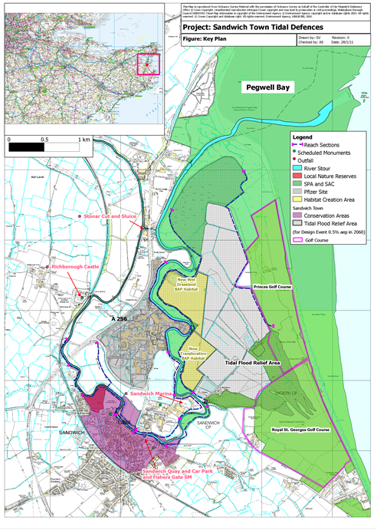
4.4 Sandwich - Introduction
1
2
3
4
What was the level of flood risk in the Sandwich area?
Sandwich is a medieval town and civil parish on the right bank of the River Stour in East Kent. Significant parts of the town were reclaimed from the sea in the 13th century and the area is prone to tidal flooding. In 1953 significant floods covered the whole area around Sandwich and motivated the creation of a new river bank.
The flood plain under consideration for this project (see figure top-right), comprises both banks of the river from Richborough Castle (about 10.5km upstream from the river mouth at Pegwell Bay) to the Stonar Cut (about 2km upstream of Pegwell Bay). Prior to the intervention, this area had a 1 in 20 flood risk (5%) which was expected to rise to a 1 in 5 risk (20%) by 2060, and 100% risk of flooding by 2110, if embankments were maintained at current levels. In the Sandwich area, there was a direct risk of tidal flooding to 488 residential properties and 94 commercial properties, including the large Pfizer Global Research Centre site, and local monuments. Local analysis estimated there was likely to be an estimated 6 fatalities over the next 10 years, expected to rise to 3 fatalities per year by 2060. Beyond 2060 part of the town would be uninhabitable.
The intervention
In this case study, we assess the intervention to develop flood defences in Reach 8 – Sandwich and Stonar Loop. Investment in FCERM developed the preferred “Improve” option, which brought the site a 1 in 200 level of protection. Funding was provided by three parties to develop embankment raising, improved and raised defences, a tidal flood relief area and flood walls. Kent County Council invested £3.28m capital and £1.36m for maintenance after construction, Pfizer invested total of £6.5m towards construction, and the Environment Agency invested £11.92m capital and £1.65m for maintenance (FDGiA).
The structure of funding provided was largely shaped by Pfizer’s decision to leave the local area. It employed about 2,400 local people in the East Kent region. This, combined with further anticipated job losses in the area meant there was a risk of combined job loss of 7,800 by the end of 2011. The need to protect jobs motivated the Council to set up a Taskforce, focused on leading a recovery for East Kent. A central element of that recovery was to address the flood risk. Pfizer were motivated to be involved in this because the value of the land they wanted to sell when they moved would have been far lower because of the flood risk. Investing in FCERM would bolster the market price for the site upon sale. They also felt a commitment to the local community having been there for so long. The local Council invested in order to support job protection in the area and to secure Pfizer’s contribution.
Local area including flood plain
Source: Environment Agency – Sandwich Town Tidal Defences PAR, Feb 2011
Key points on investment in the intervention:
The “Improve” option implemented reduced the risk of flooding from 1 in 20 to 1 in 200.
Total capital investment was £21.7m (£3.01m for maintenance)
Investment was funded by public and private bodies: Kent County Council, the Environment Agency and Pfizer.

Slide 41
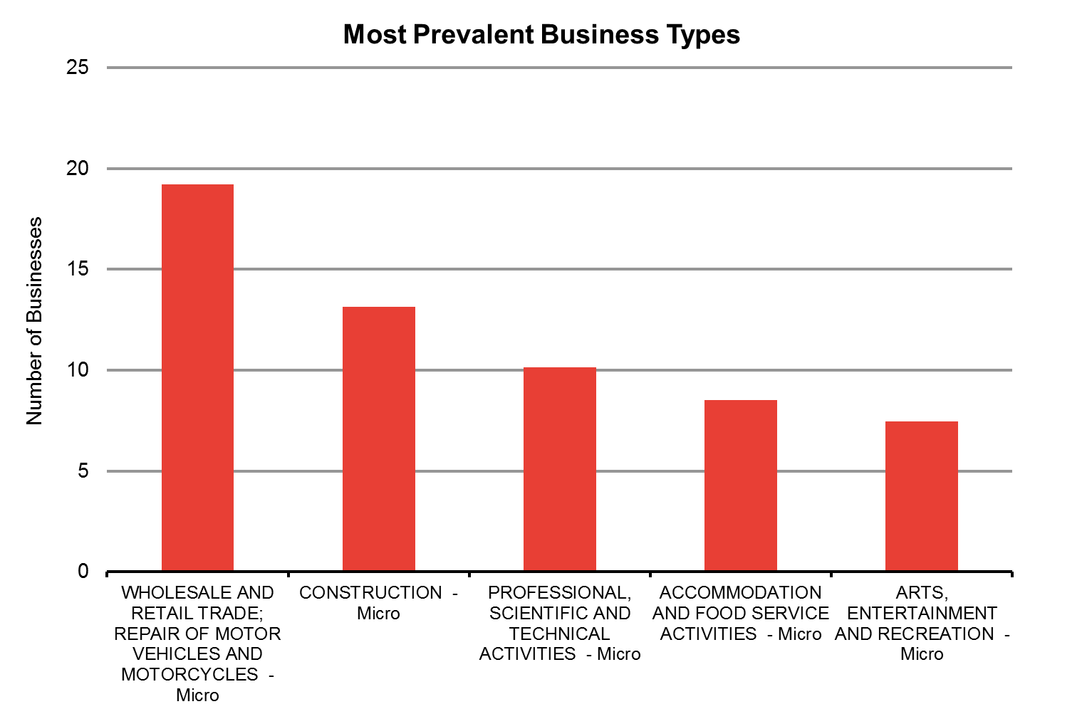
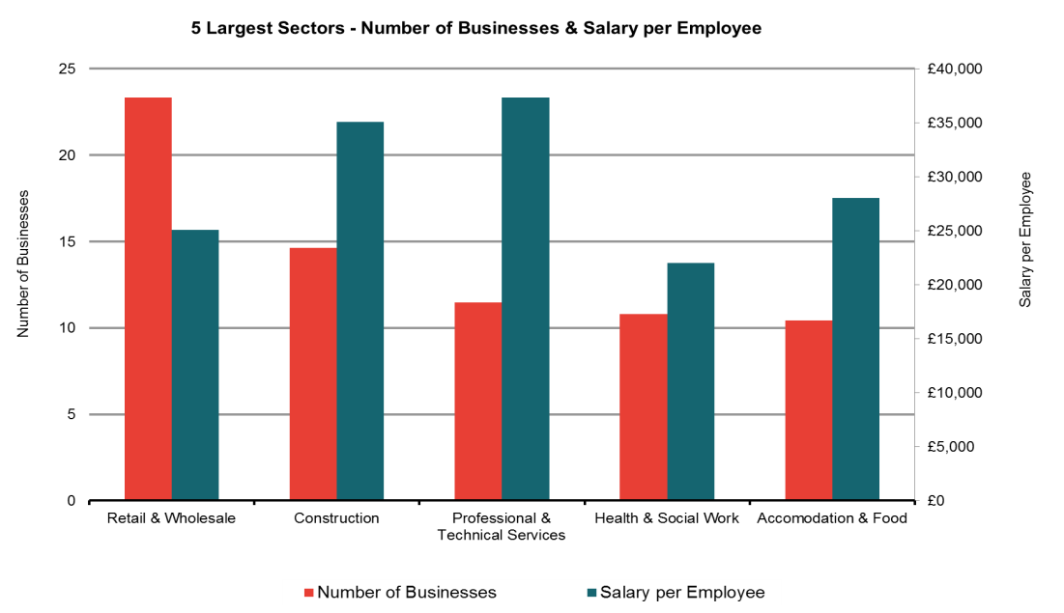
4.4 Sandwich – Business Categorisation
1
2
3
4
Economic activity in the local area
Sandwich had a significant pharmaceuticals industry with the presence of the Pfizer research site, developed in 1957. The company has a long and deep history with the local community, providing employment for over 2,000 people in the area. Pfizer’s investment in the local flood defences was commercially motivated to enable sale of the industrial site on which it was located, as well as having a corporate social responsibility motivation given the historical connection with the local community.
Alongside pharmaceuticals, tourism is also an important part of the local economy, given the prevalence of heritage assets and summer time attractions. There is also a significant amount of agricultural land at risk of flooding to the east of Sandwich town.
Business Categorisation
The existing appraisal identified 123 commercial properties at a 1 in 20 risk of flooding in the Sandwich area in 2007 under the “Do Nothing” scenario. In line with Technical Report 1, we used local authority data from the ONS Neighbourhood Statistics database to assess the sector composition of these businesses. Although there has been significant investment and business development in the local area since the investment in FCERM, the data is considered pre-intervention.
The data indicates that:
Wholesale and retail trade businesses are the most prevalent in the Sandwich economy, while the role of tourism is evident with a variety of hospitality businesses. The data also reflects wholesale of pharmaceutical products (Pfizer). Given the retail and service provision of businesses in the Sandwich area, they are likely to have capital and stock on site, increasing their susceptibility to business disruption in the wake of flooding.
Of the 123 businesses at risk of flooding, 100 are micro, 22 are small and only 1 is large. The presence of the Pfizer site dominates the local economy, while the rest of the commercial businesses in the area are local and thus likely to have small local supply chains. Furthermore, these small businesses are less likely to have the ability to insure themselves against risk of flooding.
Source: Frontier analysis based on ONS and BIS data
Source: Frontier analysis based on ONS and BIS data

Slide 42
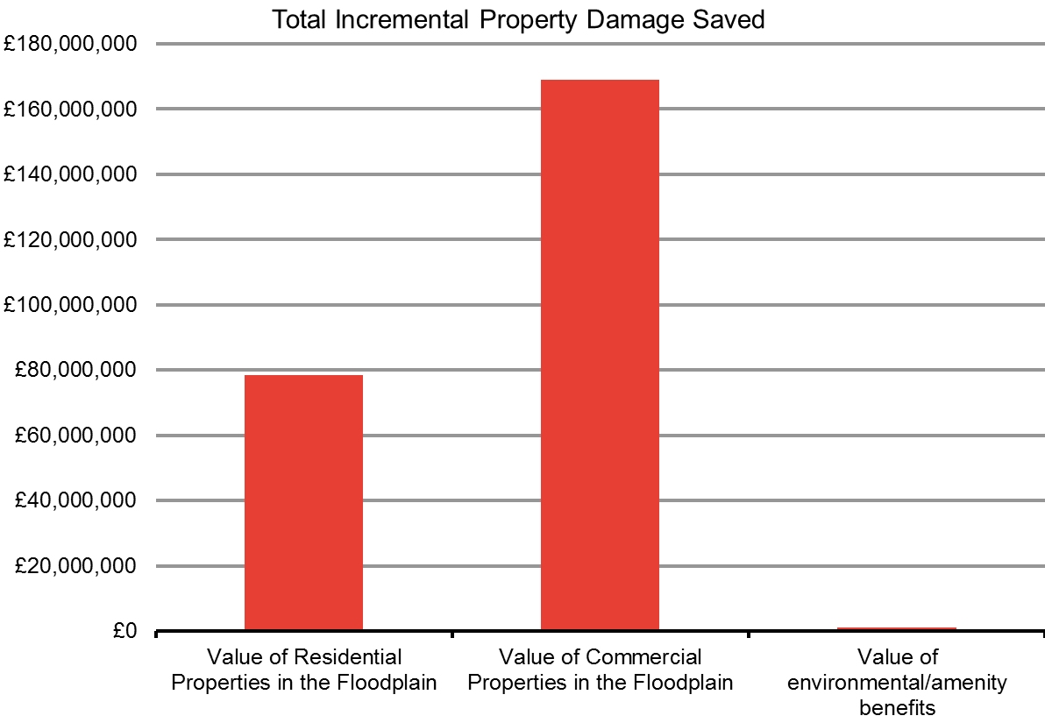
4.4 Sandwich – First Round Impacts
1
2
3
4
What first round impacts does the Sandwich scheme generate?
Under the EA’s project appraisal of the Sandwich scheme, the value of residential properties, commercial properties and environmental and amenity benefits were reported. Given its scale, the Pfizer site accounts for a significant proportion of the overall expected damage costs. The site is a major pharmaceutical management, research and development site comprising 138 hectares with extensive offices, production facilities, high-tech labs and supporting infrastructure. A number of other sectors were also directly at risk of flooding: local amenities which support the tourism sector, including listed buildings, historical structures and gardens, important road and rail transport links, approximately 3 km squared of agricultural land and local services and utilities including sewage treatment and drainage infrastructure.
As noted earlier, 94 commercial properties are at risk from flooding. Based on the information in the EA’s project appraisal, comparing the estimated damage costs in the “do nothing” scenario with the “do something” FCERM intervention, the PAR suggests:
From the EA’s project appraisal, the PV estimates of the damage costs under the “Do Nothing” scenario (without the FCERM intervention) were £249m across all residential, commercial and risk to life damage. Commercial damage is 67.9%, £169million of this, and is dominated by the Pfizer site, (£75m).
Given Pfizer exited the area near the start of the appraisal (for reasons not related to flooding), the expected benefits accruing to the Pfizer site have been subtracted from the total. This avoids us counting a benefit that is not likely to have materialised.
Comparing the estimates of expected damage to properties in the “do nothing” scenario, with damage expected under the scenario with the FCERM intervention – the “do something” - the avoided damage cost to commercial property is £3.3million on an undiscounted annual basis. This annual average is a GVA effect. When converted to our ten-year GVA present value, this is £27.1million.
Source: Frontier analysis based on data in the Project Appraisal Report
Annual Benefits
£3.3m
10 year PV Benefits
£27.1m

Slide 43
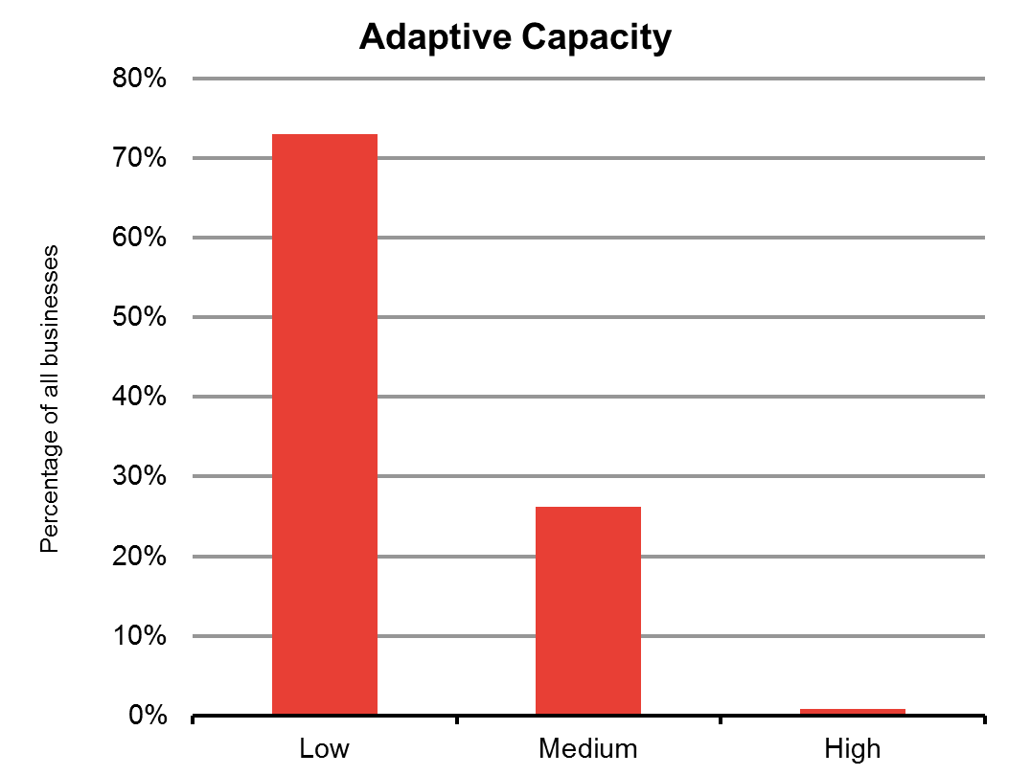
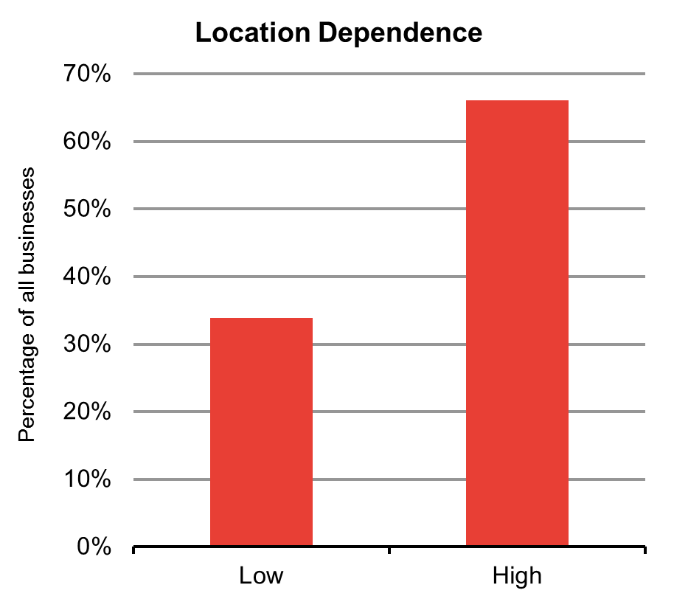
4.4 Sandwich – Adaptive Capacity & Location Dependence
1
2
3
4
What is the likely Adaptive Capacity and Location Dependence of local businesses?
Published evidence indicates that large and medium-sized businesses in particular sectors would be more likely to have the capacity to adapt or to relocate because they are more likely to have both the finances and the awareness to adapt. In contrast, small businesses are more likely to have much lower adaptive capacity, given lack of awareness, financial constraints and lack of property ownership (they often lease their properties).
Published evidence indicates that, outside of the large Pfizer pharmaceutical site, most businesses in the Sandwich flood plain are small and micro sized. These businesses operate across a variety of industries, though are most focused in wholesale and retail, and serve the tourist sector. Evidence from the PAR indicates that these commercial properties in the Sandwich flood plain are on average 270 square metres, with a flood threshold of 3.4 metres high (i.e. they would flood if water were 3.4 metres above sea level).
Their small size, sector composition and low threshold to withstand flooding, means that businesses in the Sandwich floodplain are likely to have little ability to adapt to the risk of flooding and would suffer significant damage to commercial and productive capabilities with flooding.
This is evident in the adaptive capacity and location dependence characteristics of the local economy. We estimate that:
Around 70% of businesses in the Sandwich flood plain are likely to have low adaptive capacity and only 1% have high adaptive capacity.
66% of businesses in the Sandwich flood plain are likely to have high location dependence and 31% have low location dependence.
Source: Frontier analysis
73% of businesses are likely to have low adaptive capacity
66% of businesses are likely to have high location dependence
Source: Frontier analysis

Slide 44
4.4 Sandwich – Business Responses
1
2
3
4
Evidence from local business representatives
Evidence from local business representatives highlights the importance of considering local factors and motivations for investment in FCERM that may not be evident in data alone.
Stakeholder evidence supports the data that businesses in the Sandwich area are unlikely to move or adapt in response to the risk of flooding.
Without the flood risk management intervention the site would be likely to have lower value because the key employer in the area – Pfizer – had announced it was going to move. Before moving out (for non-flood risk reasons), Pfizer would have developed parts of the site, but would have been likely to demolish a significant proportion of the industrial space.
The impetus to invest in flood defences came from a need to support employment and local regional development in the wake of Pfizer’s departure. It was with the imminent departure of Pfizer from the local area that Kent County Council addressed the local need for FCERM. Despite the fact that the Sandwich flood plain had a 1 in 20 risk of flooding, Kent County Council did not seek investment prior to Pfizer’s announcement they were leaving the local area. With the sale of the Pfizer site proving difficult given the risk of flooding, Kent County Council was explicitly motivated to ensure continued employment in the Sandwich area. This, combined with the need to secure Pfizer’s contribution towards the FCERM intervention, fuelled the Council’s investment in FCERM.
The combination of low adaptive capacity and high location dependence results in most businesses being unable to adapt to the risk of flooding. On the basis of our analysis, we estimate:
7-21% of businesses are likely to stay and adapt
79-93% of businesses are likely to stay and do nothing
As part of our analysis, we assume that those taking adaptation action in the absence of the FCERM intervention, would also choose to adapt if the scheme was implemented, with the only difference being the level of adaptation investment made. Businesses may adapt to a lesser degree to reflect the new lower risk of flooding. Given the composition of businesses in Sandwich of mainly small and micro businesses, most are likely to stay and adapt or stay and do nothing. However, it is possible that businesses opt to move or to shut down. Given this is likely to be the least preferred option, this is only illustrated as a sensitivity test:
If we assume that 1-5% of businesses that have medium to high adaptive capacity and low location dependence move then perhaps 1 business would leave the Sandwich local economy.
If we assume that 1-5% businesses that have low adaptive capacity and high location dependence shut down completely in the face of flooding, then perhaps 3 of Sandwich’s businesses would close.
Key points on business responses:
Small, wholesale and retail, construction, professional businesses with low flood thresholds are most at risk of flooding, yet they are unable to adapt as they are likely to have low adaptive capacity
7-21% of businesses are likely to stay and adapt. This means that between 9 and 26 businesses are likely to protect themselves from flood and coastal erosion risk.
79-93% of businesses are likely to stay and do nothing. This means that between 97 and 114 businesses are not likely to adapt to flood or coastal erosion risk.
Likely Business Responses
To determine the likely business responses of each business in the floodplain, we again used the preliminary “business look-up table”. We then apply this to the business characterisation of the area. The look-up table suggests the likely responses (either staying and adapting or staying and doing nothing) of each type of business, given their level of adaptive capacity and location dependence, corroborated with local stakeholders. To capture the uncertainty around exactly how many businesses may respond to flood risk, ranges are presented.

Slide 45
4.4 Sandwich – Dynamic Impacts: Direct Effects
1
2
3
4
What are the dynamic impacts?
Using the estimated range of business responses, we can explore the likely dynamic impacts of flooding and FCERM. In the absence of FCERM intervention, based on a review of evidence, we assume a business could be disrupted for around 16-24 weeks because of flooding and 2-4 weeks in areas at low risk of flooding (i.e. with the FCERM intervention).
Overall, we find that as a result of the majority of businesses being small with low adaptive capacity and high location dependence, the intervention in Sandwich could bring about significant increases in GVA and benefits for the local economy.
For businesses that stay and do nothing, the dynamic impact estimated is based on reductions in expected annual disruption costs faced as a result of business operations being interrupted due to flood or coastal erosion. Under the assumptions above, with no FCERM, expected disruption could be equivalent to an estimated £0.57m-£1.7m per annum. Reducing the level of flood risk and the likely length of business disruption to 2-4 weeks ,the equivalent expected annual cost of the intervention could fall to £14,100-£14,300. The reduction brought about by the FCERM investment could therefore be estimated to be around £0.56-£1.68m on an annual basis. This equates to an estimated increase in GVA of approximately £4.6m-£13.9m over the ten-year appraisal period compared with the ‘do nothing’.
When businesses stay and adapt, we assume that they adapt ‘optimally’ given the risk of flooding they face i.e. the reduction in expected annual damage and disruption costs is equal to their investment in adaptation. The implementation of FCERM reduces the business’s need to invest in adaptation. Since the funds freed up for investment in other activities would provide broadly comparable returns to those that they would have provided when invested in adaptation, the value of the damage avoided by adaptation provides a reasonable approximation of the GVA impact of the investment of the funds freed up and is an estimate that more readily available (from the FCERM-AG) for use in the analysis.
Most of the GVA impact is driven by micro and small businesses –only 1% is attributable to large businesses.
Protection to sectors such as human health and social work activities, and wholesale retail trade; repair of motor vehicles and motorcycles would be likely to account for the majority of the GVA contribution in the local Sandwich economy.
The impact on local GVA of businesses moving or shutting down is uncertain. To illustrate the potential scale of impact on GVA, we can adopt the sensitivities previously outlined.
If 1-5% of businesses move out of the Sandwich local economy in response to flood and coastal erosion risk, where FCERM is able to prevent this loss to the local economy, this would be equivalent to retaining £166,000-£830,000 GVA in the local area per annum.
If 1-5% businesses in Sandwich shut down due to flood and coastal erosion risk in the absence of FCERM intervention, where FCERM is able to prevent this, then this would be equivalent to retaining £136,000-£681,000 GVA per annum in the local area.
Given that there is insufficient evidence to be able to estimate the likelihood of businesses moving or shutting down, these figures are not included in the overall calculation of dynamic impacts.
£0.56 million - £1.68 million
Potential annual GVA impact
£4.6 million - £13.9 million
Estimated local GVA impact over 10-year period

Slide 46
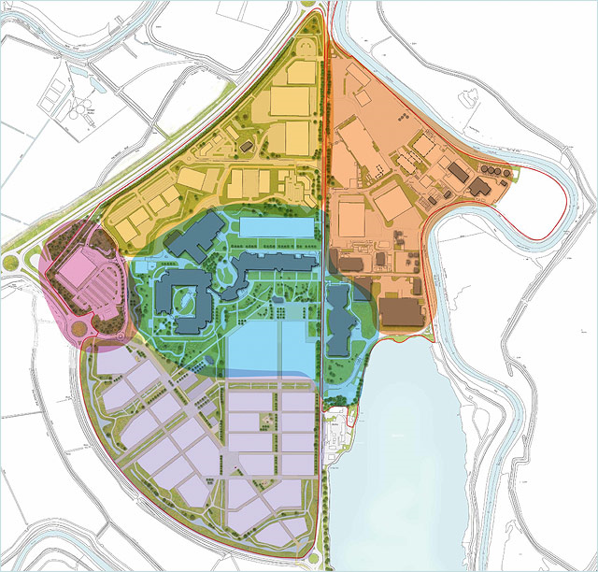
4.4 Sandwich – Dynamic Impacts: Spillover Effects
1
2
3
4
Has the scheme unlocked new investment?
After the improved flood defences were put in place, Pfizer sold the 3million square ft. Research and Development site to Discovery Park Limited for use as an Enterprise Zone. We understand without the investment in FCERM, Pfizer would have developed parts of the site, but likely would have demolished a significant proportion of the industrial space. The investment in FCERM has supported the development of new businesses in the Sandwich area – it was a necessary but not sufficient condition for the Pfizer site to become an Enterprise Zone because planning permission is not likely to have been possible without it.
Although Pfizer has largely exited the site, given local supply links in some of its production processes, it maintains 800 jobs on the site. 65 new businesses have been set up at the Discovery Park (at the time of drafting). Approximately 100-150 people are employed at product range spin-off companies, and there are 10-12 spin-off science companies with 3-10 employees in each. Assuming a conservative 3 jobs per new business, and by applying the average salary per employee for wholesale and retail trade and repair of motorcycles and motor vehicles, the Discovery Park could generate annual GVA equivalent of perhaps £4million in the local area. Companies include Augean, Mylan, LGC, Peakdale Chemistry Services, Reeves, Cleantec Innovation and Digital Detective. Estover Energy is also planning to develop a £65 million biomass Combined Heat and Power (CHP) plant at the Park to supply power to the site and energy to 20,000 homes. The remaining companies are varied covering a range of industries such as IT and créche and childcare facilities.
What are the additional spillover impacts of the scheme?
Under the Enterprise Zone status of the Pfizer site, businesses can benefit from zero business rates, (worth approximately £55,000 a year) for 5 years, further encouraging local business development. On top of this, the focus by the Council Taskforce into local area recovery has also led to a local marketing campaign “Locate in Kent” which has secured £125million in investment over the past five years, generating over 3,800 jobs, and delivered a £35million package of financial support for business secured through the Regional Growth Fund (offering interest free loans for local business investment) and enabled the development of a £10million scheme to deliver High Speed rail to Sandwich and East Kent.
Sandwich Discovery Park
Source: Discovery Park website http://www.discovery-park.co.uk
Investment in FCERM was a necessary but not sufficient condition for Kent County Council’s successful application for Enterprise Zone status of the Pfizer site.
The Enterprise Zone has brought 65 new businesses to the Sandwich area which would likely not have been developed in the absence of the FCERM intervention.
A large proportion of these new businesses are product range and science spin off companies given Pfizer’s historical presence in the area.
With the EZ and resulting support and development for the Sandwich area, up to £225million of additional investment and supporting GVA has been facilitated.
Further plans off the back of the EZ development have improved transport links, and local marketing campaigns reported to have generated over 3,800 jobs in the past 5 years.

Slide 47
4.4 Sandwich – Total estimated impact of FCERM on GVA
1
2
3
4
The Sandwich scheme could potentially provide £0.56-£1.68m GVA per annum in dynamic impacts to the local economy in addition to first-round impacts.
Given the high property values and high local dependence of most of Sandwich’s businesses, a significant proportion of the economic benefits come from the first round impacts.
FCERM was necessary (but not sufficient) to unlock substantial investment in support of economic activity. Without investment in FCERM, with Pfizer’s departure of the local area the site would have been under developed and largely demolished. Only with the investment was future employment secured via the development of the Enterprise Zone
Estimated undiscounted annual average (£)
Estimated 10-year GVA impact (£ discounted to PV)
Qualitative assessment
First Round Impacts
£3.3million
£27.1million
NA
Dynamic Impacts
£0.56 - £1.68m
£4.6m - £13.9m
Facilitated unlocked investment of potentially up to £225 million
Specific limitations
The business categorisation is based on local authority and regional business data. The actual make-up of businesses in the floodplain may differ from what we have estimated. As certain types of business are more valuable than others, this is may impact on the GVA estimates.
The scheme could have a number of spill-over effects that could materially impact on GVA, but many cannot be quantified robustly. In particular, there are likely to be impacts on other businesses through the supply chain when Sandwich businesses have a greater level of protection against flooding. There are also likely to be benefits associated with the lower level of disruption to public infrastructure services such as transport, communications, water and energy.

Slide 48
5.1 Summary of key findings from the case studies
This report has explored the potential contribution to the local economy from investment in flood and coastal erosion risk management. Four case studies have been explored to test a new methodology for assessing such impacts. Commentary is also provided of when a contribution to the national economy are more likely.
Key findings relating to GVA impacts for the local economy
Observation | Example | Potential implication
1. Accounting for the impacts of FCERM on the local economy can add significant benefits to those already assessed under standard FCERM appraisal methods | The Nottingham FCERM intervention could offer annual benefits to the local economy of £3.1 million - £9.7 million on top of the £584,000 annual benefits already assessed under FCERM appraisal methods. | In some cases the additional benefits to the local economy can add significantly to those already assessed. This could have implications for the consideration of relative returns to FCERM investment across interventions.
2. Across all case studies, the majority of businesses are small or micro-sized (less than 10 people). Yet these are most likely to lack adaptive capacity and be at risk of significant flood disruption costs. | Across all four case studies, 70-75% are likely to have low adaptive capacity. Godmanchester, Redcar and Sandwich all have significant proportions of micro businesses | Increasing adaptive capacity of small and medium-sized businesses, alongside wider flood risk management options, is likely to help alleviate potentially significant disruption costs in the event of a flood and contribute to GVA. FCERM plays a particularly important role where adaptive capacity is limited.
3. The local GVA impacts of FCERM are likely to be relatively greater when there are dense populations of high GVA businesses with low adaptive capacity | Nottingham has the highest density of business activity of all four case studies. | Relatively greater GVA returns from Partnership Funded FCERM are more likely in areas with dense populations of high value-added businesses with low adaptive capacity; and when the FCERM protects infrastructure on which businesses depend for their productivity.
4. FCERM has the potential to unlock substantial investment, when considered as part of a wider package of measures | Nottingham and Sandwich had Enterprise Zone developments were facilitated by FCERM; Redcar included FCERM within a broader regeneration set of measures. | This could point to the benefits of integrating FCERM into area plans for regeneration and local (or national) economic growth policy

Slide 49
5.1 Summary of key findings from the case studies (continued…)
Observation | Example | Potential implication
5. Where tourism is important to the local economy interdependencies mean FCERM can benefit not only the tourist attraction, but also the surrounding businesses and local economy (such as hotels, eateries etc). | Redcar is very dependent on tourism. A holistic area-wide integrated approach was taken to regenerating the area | Areas with significant tourist revenue benefit disproportionately from an integrated approach to flood planning
6. Interdependencies mean the system-wide benefits to the local economy from FCERM could be even greater than those that are currently amenable to quantification. | Almost all businesses have supply chains of some form and rely on public infrastructure (e.g. transport and utilities). Some businesses also benefit from co-located businesses through enhanced efficiency. | FCERM lowers the systemic risk of flooding in the local area. Understanding how businesses and organisations are interdependent on each other and infrastructure is critical to the assessment of benefits.
7. FCERM is able to indirectly support economic activity – but this benefit is also difficult to quantify | Godmanchester houses commuters who contribute high value labour to Cambridge and London. Such homes contribute to the supply of housing in the South-East | Indirect support for economic activity from FCERM could be significant – further research is needed to better understand the scale of this potential effect
Key findings relating to GVA impacts for the national economy
The analysis suggests that a contribution to the national economy of FCERM investment is more likely where:
Investment is unlocked because of the unique characteristics of the local area (and that investment would not otherwise be made in another area)
Agglomeration benefits or other interdependencies: if businesses are able to remain in their first-best location (where they are more productive) rather than moving to a less productive area, then the national economy benefits from agglomeration and the efficiencies of interdependencies. Protecting supply chains or infrastructure in which businesses rely is also likely to lead to a national gain.
Lowering damage to commercial property, public infrastructure and agricultural outputs is a national benefit.

Slide 50
5.2. Final reflections on the methodology
The methodology – learning points
One of the reasons for undertaking the case study analysis is to test out how the methodology can be applied and if there are any learning points that we can identify. The following are our observations:
We have applied the methodology to 4 case studies and we think that it is able to deliver plausible results for the contribution to local GVA.
We have relied upon published evidence and targeted stakeholder engagement where possible – this keeps the approach more tractable given the need for proportionality
One limitation of the approach is that we have used available employment data from the Annual Survey of Hours and Earnings and BIS Business Population Estimates for the UK and regions. Using data at the regional level may mean the composition of actual businesses in the local floodplain may differ from the regional composition assumed. The business composition should be explored with stakeholders as part of interviews.
Stakeholder engagement was a very informative part of the work and we would encourage practitioners to undertake a series of interviews to understand the nature of the economic activity, the extent to which businesses are likely to be aware of the risk and are likely to adapt.
Evidence gaps
There are some notable gaps in the evidence base for which further research would be useful in order to enhance the methodology going forward. These relate to:
Understanding of the degree of interdependency of businesses on each other and their reliance on surrounding infrastructure.
The number of businesses who would be likely to move or shut down in response to flood risk. This is particularly uncertain because it is very case specific. A greater understanding of this risk could enhance the methodology.
There is little evidence available on the degree of business displacement and additionality. This refers to the fact that new investment facilitated by FCERM could be a net addition to the national economy, as well as the local economy, or it could just be the latter.

Slide 51
annexes

Slide 52
Annex 1: Stakeholder Evidence - Godmanchester
To gather specific evidence on businesses in the Godmanchester area, we undertook interviews with various stakeholders. This Annex summarises the evidence regarding the likely adaptive capacity and location dependence of local businesses, and their likely responses to the risk of flooding.
Adaptive Capacity and Location Dependence
Lack of awareness of flood risk (short term planning horizon). Businesses concentrate more on short term rather than longer term risks. Stakeholder mentioned that businesses care more about the things that affect the day-to-day running of their business, rather than about the risk of a flood that may or may not occur in 5 or 10 years time. The likely risk of flooding is therefore of low priority when making their key businesses decisions.
Lack of knowledge on how to adapt. Stakeholders believed that even if businesses were aware of the risks, many would not have the knowledge or information on how to protect themselves effectively. None of the stakeholders were aware of an advice service that would provide information to businesses on possible ways to adapt.
Physical barriers. Stakeholders mentioned that a large proportion of commercial properties in Godmanchester are old listed buildings. This would make it particularly difficult to gain planning permission for physical adaptation to properties, if such adaptation would change the structure or appearance of the building. As the majority of buildings are made of old stone, this would also make it physically difficult to adapt the property in a significant way.
Perceived lack of responsibility. Many businesses believe it is the responsibility of local government to provide flood protection, and could therefore not justify any personal investment in adaptation.
Property ownership. The majority of the at-risk businesses rent or lease their commercial property. One stakeholder mentioned that this may limit the willingness of businesses to protect themselves against flooding.
Likely Business Responses
Businesses would be unlikely to re-locate in response to flood risk. Although stakeholders noted that some businesses could potentially move to Huntingdon and avoid any risk of flooding, none was aware of any business that had done so solely as a result of flooding. However, some noted that business premises tend to change hands quite a lot in Godmanchester, so it’s not clear where businesses go and for what reason.
The majority of businesses would not be likely to adapt to mitigate the risk of flooding they face. Given the significant barriers to adaptation, in particular businesses’ lack of awareness of flood risk and the low importance they place on flooding as something that affects their businesses, many stakeholders believed that only a small proportion of businesses would choose to actively protect themselves. One stakeholder mentioned he was aware of only a few businesses that had taken steps to protect their properties following the Easter 1998 floods.
However, there was a view that businesses would make small investments in adaptation if it was cost effective. A few stakeholders mentioned that businesses would invest in physical measures such as sandbags, it they were aware of the benefits.

Slide 53
Annex 1: Stakeholder Evidence - Nottingham
To gather specific evidence on businesses in the Nottingham area, we undertook interviews with various stakeholders. This Annex summarises the evidence regarding the likely adaptive capacity and location dependence of local businesses, and their likely responses to the risk of flooding.
Adaptive Capacity and Location Dependence
Large, as well as medium-sized businesses in particular sectors, would more than likely have the capacity to adapt or re-locate. Stakeholders cited that large businesses will have both the finances and the awareness/knowledge to adapt, and also have ‘the most to lose’ in the event of flooding. Medium-sized businesses in sectors were risks are dealt with on a day-to-day basis (for example in regulated industries) will also be aware of the flood risks they face
Small businesses however are likely to have much lower adaptive capacity, driven by a number of different factors. Stakeholders cited various barriers to adaptation, including:
Lack of awareness of flood risks, and possible ways to adapt. A number of stakeholders cited that generally, only those small businesses who have has previous experiences of flooding would be aware of the risks they face. Small businesses are also unlikely to have the information to judge what the most effective ways to protect themselves are.
Financial constraints. Many small businesses are likely to be restricted by lack of funds. This restricts their ability to re-locate, and only allows them to adapt if adaptation actions are extremely cost-effective.
Lack of property ownership. Many small businesses are likely to lease or rent their commercial properties. This means businesses may not realise the full benefits of self-protection. Stakeholders also mentioned that most landlords are unwilling to fund self-adaptation projects.
Businesses of all sizes may face emotional barriers to adaptation. Stakeholders cited examples of business owners trying to ‘forget’ past flood events, rather than protect themselves against floods in the future.
Flooding may not be the most important risk facing some businesses. Stakeholders mentioned the construction of a new tramlink in the city, which has significantly impacted on trade in areas such as Beeston. Businesses in
these areas are therefore likely to focus on this, rather than on actions to mitigate the risk of flooding they face.
Businesses owning their own property face particular barriers to re-locating. These businesses may find it particularly difficult to re-locate, given the potential difficulty in (i) finding potential buyers (given the cost of the insurance needed to secure business mortgages in at risk areas), and (ii) finding likewise properties elsewhere (as property prices elsewhere will be higher all else equal, given the risk of flooding).
Likely Business Responses
Large businesses are only likely to move as a last resort. Stakeholders noted that large businesses would be unlikely to re-locate, given the majority have a large fixed asset base that would make moving particularly costly. No stakeholders were aware of any businesses that had moved as a direct result of flooding.
Large and medium-sized businesses are likely to adapt to high levels of flood risk. Stakeholders cited that such businesses are likely have both the finances and the awareness/knowledge to adapt, and are also likely have ‘the most to lose’ in the event of flooding.
Small businesses that are aware of flooding would choose to adapt rather than re-locate, but still may not do so. According to stakeholders, small businesses would be unlikely to have the funds to re-locate, and would be particularly reliant on local connections for business. Small businesses owning their own property would find it particularly difficult to re-locate, given the barriers highlighted on the previous slide. Nevertheless, small businesses would also find it particularly difficult to adapt, given the financial and informational barriers they face. These businesses are therefore most likely to suffer significant damage to commercial and productive capabilities in the event of a flood
However, small businesses at high risk of flooding will adapt. Stakeholders cited a number of small businesses (such as pubs) who flood on a regular basis that had installed flood-resilient doors, window boards and bought ‘aqua bags’ which soak up incoming flood water.

Slide 54
Annex 1: Stakeholder Evidence - Redcar
To gather specific evidence on businesses in the Redcar area, we undertook interviews with various stakeholders. This Annex summarises the evidence regarding the likely adaptive capacity and location dependence of local businesses, and their likely responses to the risk of flooding.
Adaptive Capacity and Location Dependence
Small businesses however are likely to have much lower adaptive capacity, driven by a number of different factors. Stakeholders cited various barriers to adaptation, including:
Financial constraints. Many small businesses are likely to be restricted by lack of funds and reported difficulties in accessing insurance. This restricts their ability to re-locate, and only allows them to adapt if adaptation actions are extremely cost-effective.
Lack of awareness of flood risk (short term planning horizon). Businesses concentrate more on short term rather than longer term risks. Stakeholder mentioned that access to information on risk of flooding was limited and they were reliant on local and national news reports for understanding of upcoming risk. Before the first time the stakeholder was flooded they were unaware they were at risk of flooding.
Lack of knowledge on how to adapt. Stakeholders believed that even if businesses were aware of the risks, many would not have the knowledge or information on how to protect themselves effectively. None of the stakeholders were aware of an advice service that would provide information to businesses on possible ways to adapt. However, stakeholders outlined their response plan to imminent flood risk and some staff training to ensure a quick internal response.
Likely Business Responses
Small and medium businesses are likely to stay and attempt to adapt or stay and do nothing. Given the prevalence of small and locally owned businesses in the Redcar area, particularly along the seafront, stakeholders reported that they would try and face the flood risk but faced obstacles in adapting. Stakeholders mentioned the operational difficulties they faced in adapting and responding to flood risk given the machinery they held on site and the short notice they received in response to risk of flooding.
Businesses likely to move or shut down, if risk of flooding does not abate. The repeated damage caused by flooding, combined with the difficulties faced in physically adapting, or accessing funds to support private adaptation, they would have to consider closing down the business, or moving entirely if it were financially viable with the risk of flooding.
Customer loyalty impacts on a business response decision and can vary by sector. Stakeholders reported that customers can be loyal to some local businesses which provide manufacturing or services to the area and thus they can bounce back after the risk of flooding, given repeat customers. However, businesses located on the seafront and operating in the tourist sector, where damage from flooding can be significant, may be more reliant on one-off customers. Tourists can be likely to choose alternative holiday destinations given negative media reports and thus there can be longer term heavier impacts on these businesses.

Slide 55
Annex 1: Stakeholder Evidence - Sandwich
To gather specific evidence on businesses in the Sandwich area, we explored with stakeholders the development of the Discovery Park on the Pfizer Site and the connections to unlocked investment in the local area. This Annex summarises this evidence regarding the likely business response of large businesses and the impacts this can have on unlocked investment.
Likely Business Responses
Large businesses may stay and adapt. Stakeholders reported that the decision by Pfizer to leave the Sandwich area was not informed by the risk of flooding. If a joint funding agreement between the local council and the company had not been secured, we understand that Pfizer would have developed the site and tried to secure new business investment. This would indicate that large businesses may be more likely to stay and adapt rather than risk moving given the large operational, employment and logistical costs involved.
Unlocked Investment
The role of joint funding schemes can play an important role in unlocking investment in a given area. A public private partnership can allow for more investment in FCERM than either party would be able to individually attain. With joint funding, it is possible to lend extra business and enterprise support to an area, and with this “vote of confidence” attract other businesses to an area. New businesses can avail of previous infrastructure and benefit from business links in an area. Stakeholders reported that a proportion of new business development was due to spin off companies.
New unlocked investment can be widespread and indirect. Stakeholder evidence suggested a range of much wider benefits of FCERM investment in the Sandwich area, than the direct new business entities on the redeveloped Pfizer site. Furthermore, the direction of influence may not always be clear. The significant transport and infrastructural developments in the Sandwich area are likely to be a function of the original investment in FCERM although it is not clear whether these would have happened as part of a general regeneration plan if the investment in FCERM had not happened.

Slide 56
Annex 2: Assumptions/ Data Used
Data Used
Employee Numbers. We assume that on average, Micro, Small/Medium, and Large businesses employ 5, 130, and 300 individuals respectively (mid-point of the ONS range for these categories).
Annual earnings per employee. We use mean regional salary data from the Annual Survey of Hours and Earnings (ASHE). This provides average and median salary data for each business sector in each region of the UK, allowing us to apply different salary figures for different business types. Where sectoral salary data is not available, we apply the average salary for the region in which the floodplain is located.
Assumptions
There is inherent uncertainty surrounding the dynamic impacts of the schemes. In order to capture this, we use a range of assumptions around key inputs in the calculations, in order to generate a range of potential GVA impacts. These assumptions are set out in the table below.
Input | Assumptions
Average length of business disruption for those who Stay + Do Nothing | Significant Flood Risk: 16 – 24 weeks Low Flood Risk: 2 – 4 weeks The calculation accounts for lost productive input time (number of employees x average salary, by sector, and converted to expected annual damage by multiplying by the flood probability.
Proportion of businesses that adapt | We assume that businesses can only adapt if they have high or medium adaptive capacity. All those with high AC adapt. Some of those with medium AC adapt and we assume that of those 25-75% would adapt
Number of businesses that move | We measure the impact of ‘movers’ as a sensitivity test. We choose businesses from particular business types depending on the most prevalent businesses in each case study area. We also consider those businesses with: High adaptive capacity (i.e. the capability to re-locate) Low location dependence (i.e. no strong ties to the local area)
Appraisal period for GVA effects | We assume 10 years. Although the FCERM main appraisal looks at 100 years to reflect the life of the asset, we consider 10 years to be a more plausible period over which to look at impacts on the economy – beyond that it is too uncertain.

Slide 57
Annex 2: Preliminary look up tables
The following are the look-up tables for adaptive capacity and location dependence for micro businesses. Please note these should be validated using local evidence from stakeholders or other sources on a case by case basis.

Slide 58
Annex 2: Preliminary look up tables
The following are the look-up tables for adaptive capacity and location dependence for small-medium businesses. Please note these should be validated using local evidence from stakeholders or other sources on a case by case basis.

Slide 59
Annex 2: Preliminary look up tables
The following are the look-up tables for adaptive capacity and location dependence for large businesses. Please note these should be validated using local evidence from stakeholders or other sources on a case by case basis.

Slide 60
Annex 3: Stakeholders
We are very grateful to the following stakeholders for their time and input to the evidence base for this report
Stuart Ainsley - Redcar and Cleveland Borough Council
Chris Allen – Huntingdon District Council
Fay Bull – Nottingham City Council – Flood Mitigation Manager
David Cotterell – Environment Agency
Vaughan Felton - Environment Agency
Phil Jones - Redcar and Cleveland Borough Council
Bruce Laughton – Nottingham City Council
James Meade – Environment Agency
Elizabeth Milne – Kent County Council
John Oliphant – Pfizer
Mr Peacock – Lakes MOT Centre, Redcar (local business)
Gill Prangnell – Cambridgeshire Chamber of Commerce
Nic Rowlinson - Environment Agency
Alan Smuk - Redcar and Cleveland Borough Council
Roger Tait - Redcar and Cleveland Borough Council
Kevan Taylor – Redcar and Cleveland Borough Council
Richard Townson – Environment Agency

Slide 61
Annex 4: References
Boots, Nottingham Enterprise Zone – Boots site – Masterplan http://www.thebusinessadvicewebsite.co.uk/files/uploads/1379406420.pdf
English Housing Survey: Headline Report 2012-13, DCLG (2013). https://www.gov.uk/government/uploads/system/uploads/attachment_data/file/284648/English_Housing_Survey_Headline_Report_2012-13.pdf
Environment Agency, Redcar Coastal Flood Risk Area, Economic Appraisal Report, June 2009
Environment Agency, Sandwich Town Tidal Defences PAR, Feb 2011
Environment Agency and Halcrow Group Limited, Sandwich Town Tidal Defences PAR, Appendix H, Economic Appraisal, 2011
Environment Agency – South East Region, Sandwich Town Tidal Defence Scheme, Project Appraisal Report, 2011
Frontier Economics, Irbaris, Ecofys The Economics of Climate Resilience Synthesis Report, 2013 http://randd.defra.gov.uk/Default.aspx?Module=More&Location=None&ProjectID=18016
Frontier Economics, Irbaris, Ecofys The Economics of Climate Resilience Business and Services Theme – Business Continuity, 2013
Godmanchester Project Appraisal Report
Jacobs, Environment Agency, Redcar Coastal Flood Alleviation Scheme, Economic Appraisal Report, 2009
JBA Consulting, Redcar and Cleveland Borough Council Level 2, Strategic Flood Risk Assessment, Final Report, 2010
Kent County Council, Pfizer, Environment Agency, Sandwich Town Tidal Defences Member Briefing, 2013
Nottingham Trent Left Bank Flood Alleviation Scheme, Project Appraisal Report, Environment Agency Midlands, 2006
Office for National Statistics, 2011 Estimates for Cambridgeshire and Inner London
Redcar and Cleveland Borough Council, Project Initiation Document, 2012

Slide 62
Annex 4: References
Redcar and Cleveland Borough Council, Regeneration Masterplan, Delivery Plan 2012 – 2017 http://www.redcar-cleveland.gov.uk/rcbcweb.nsf/B6A92D59D974642380257A4D004D7339/$FILE/Regeneration%20Masterplan%202012%202017.pdf
Redcar and Cleveland Borough Council, Regeneration Masterplan, Delivery Plan 2012 – 2017 http://www.redcar-cleveland.gov.uk/rcbcweb.nsf/B6A92D59D974642380257A4D004D7339/$FILE/Regeneration%20Masterplan%202012%202017.pdf
Redcar and Cleveland SWMP, Outline Solutions to Flooding Problems at Key Sites in Redcar, Draft Report, November 2013
Sandwich Economic Development Task Force, Kent County Council, One Year On: Building a new future for Discovery Park and East Kent
Tees Valley Unlimited, Tees Valley Enterprise Zone, 2011 https://www.teesvalleyunlimited.gov.uk/tees-valley/enterprise-zone.aspx

Slide 63

Frontier Economics Limited in Europe is a member of the Frontier Economics network, which consists of separate companies based in Europe (Brussels, Cologne, London and Madrid) and Australia (Melbourne & Sydney). The companies are independently owned, and legal commitments entered into by any one company do not impose any obligations on other companies in the network. All views expressed in this document are the views of Frontier Economics Limited.

Slide 64
FRONTIER ECONOMICS EUROPE
BRUSSELS | COLOGNE | LONDON | MADRID
Frontier Economics Ltd, 71 High Holborn, London, WC1V 6DA
Tel. +44 (0)20 7031 7000 Fax. +44 (0)20 7031 7001 www.frontier-economics.com

